Slide 1
Course Portfolio
ME107 ENGINEERING GRAPHICS

Slide 2
Course Philosophy
Write what you understand from the course. (2 to 3 Lines)
It teaches us how to create technical drawings and designs that convey information about an object.
Its relevance in engineering from your perspective. (2 to 3 Lines)
It provides a foundation for creating accurate and detailed technical drawings that are essential for communicating design ideas and specifications.

Slide 3

Course Teachers-Student Details
Students Photo
Name | Bhavesh Ishwar Bagul
Roll No. | 705
PRN No. | 202201040104
Division | G
Batch | G1
Theory class Teacher | Ganesh Shete
Drawing Hall Teacher | Ganesh Shete
CAD Lab Teacher | Ganesh Shete

Slide 4
Drawing Hall Work

Slide 5
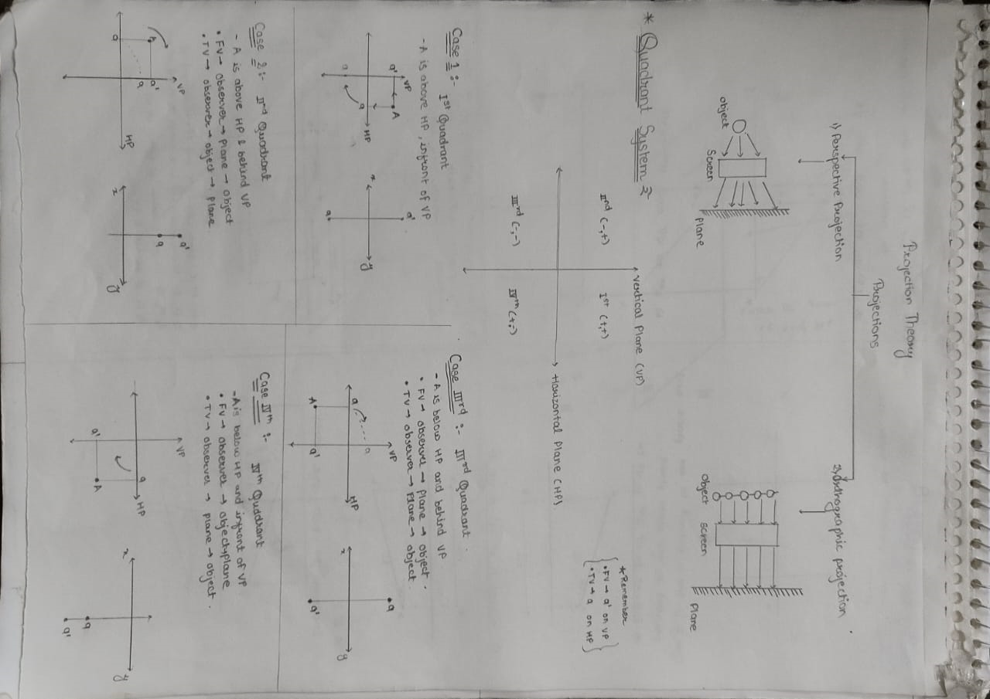
MODULE 1 QUADRANT SYSTEM

Slide 6
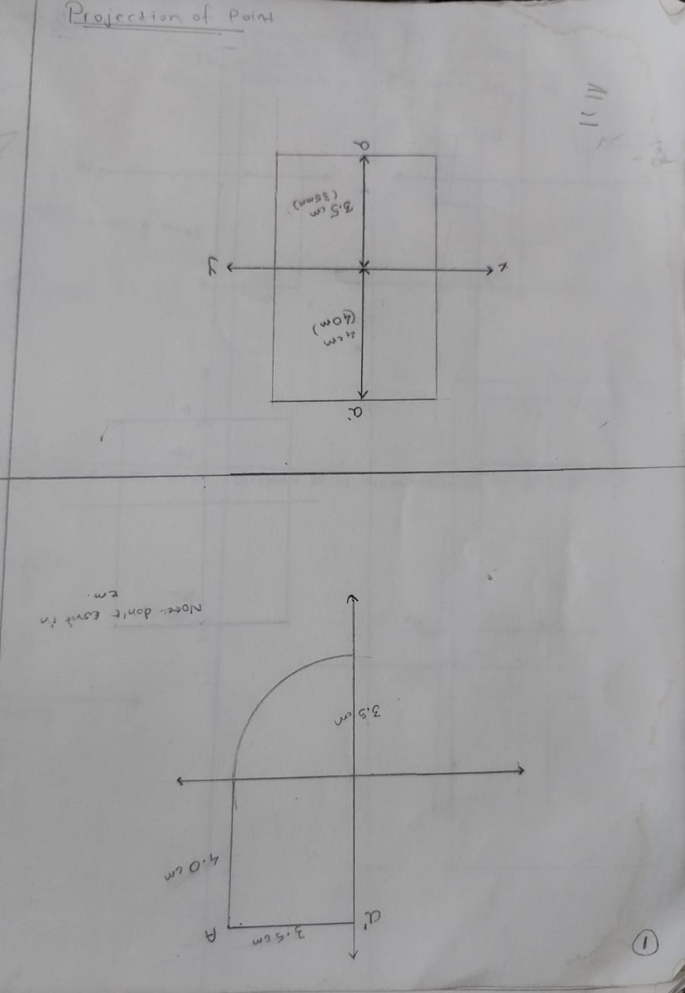

Slide 7
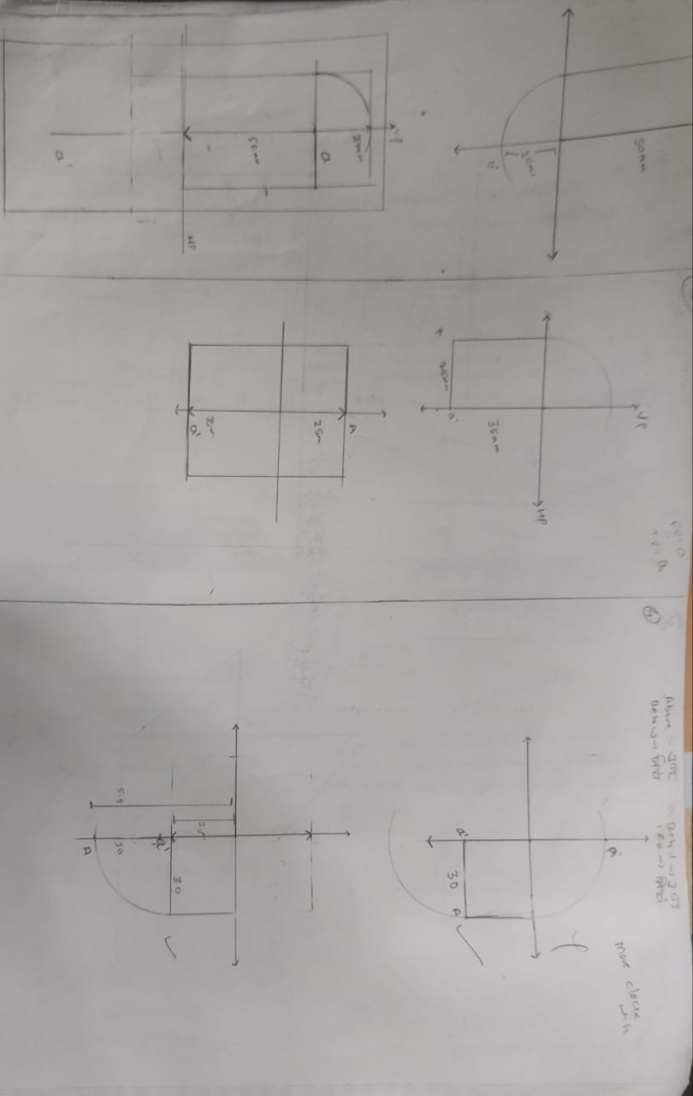

Slide 8
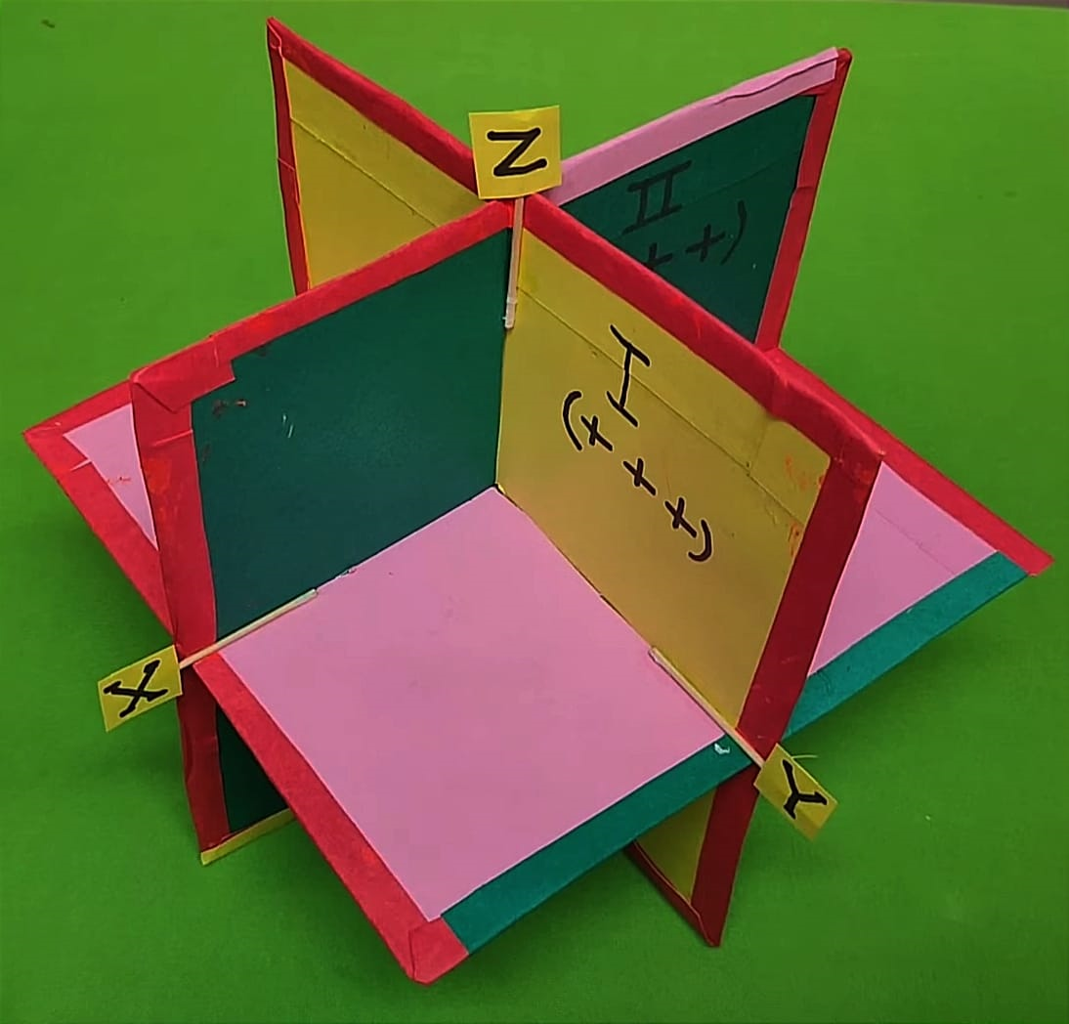
Activity carried under above Module
Quadrant Making
Photos related to activity

Slide 9
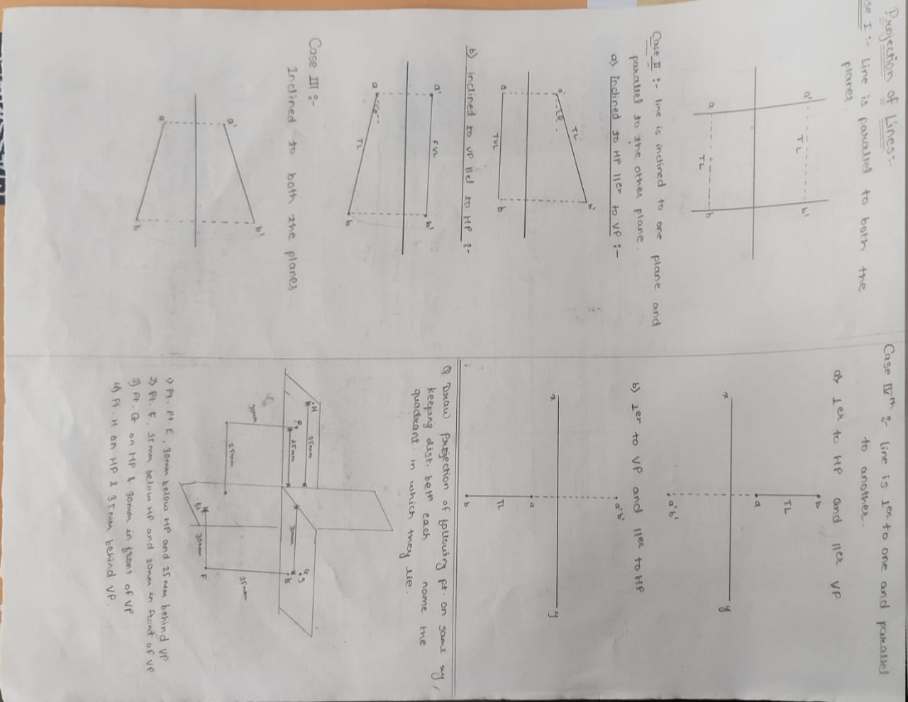
MODULE 2 Projection of Lines

Slide 10
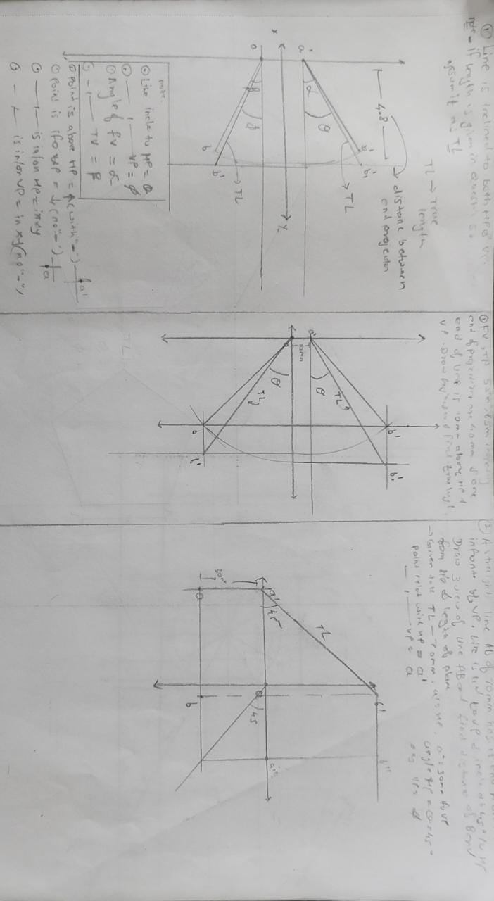

Slide 11
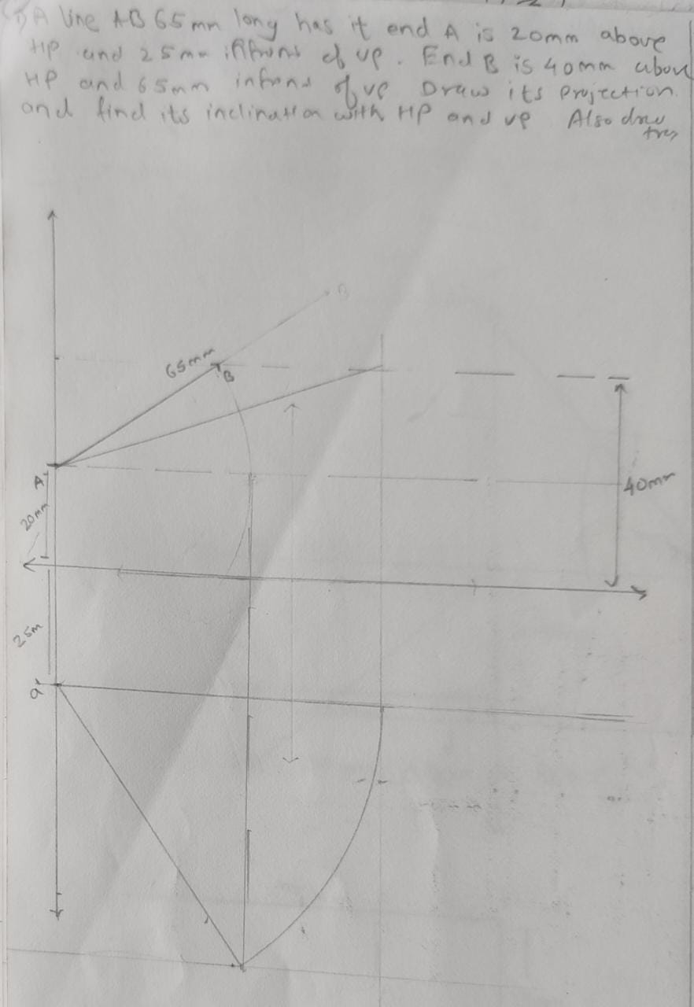

Slide 12
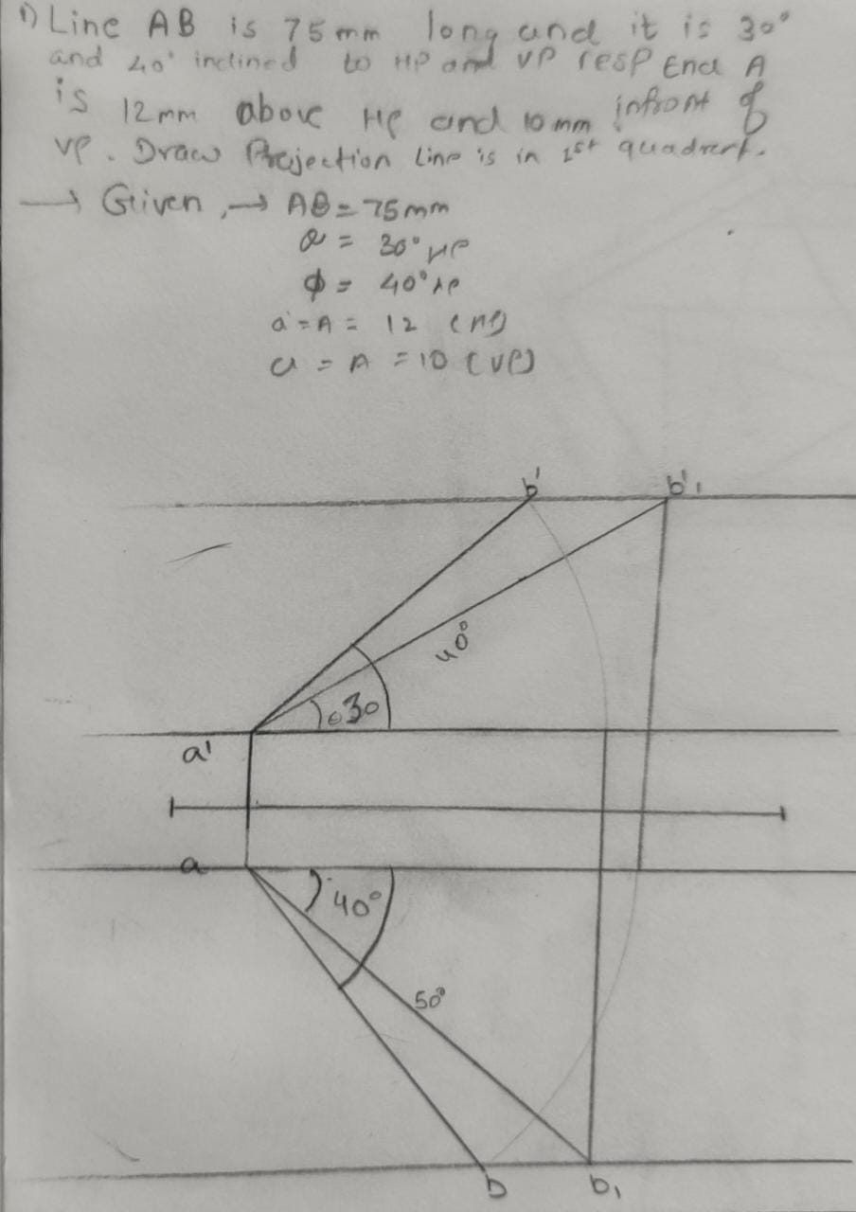

Slide 13
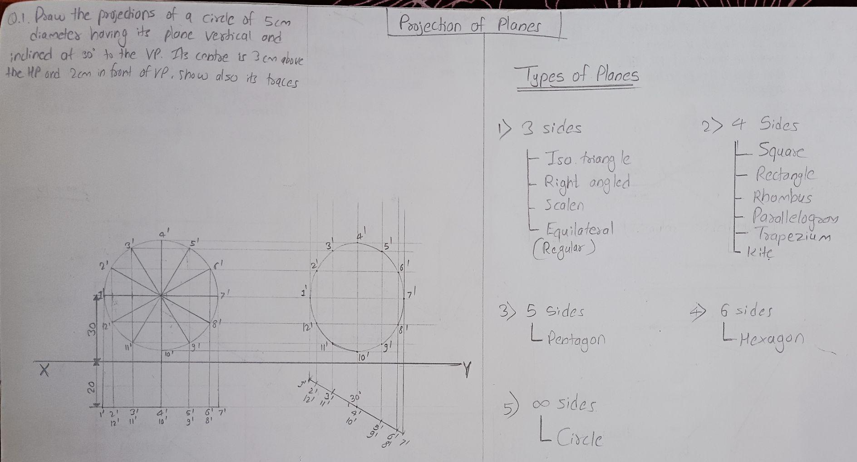
MODULE 3 Projection of planes

Slide 14
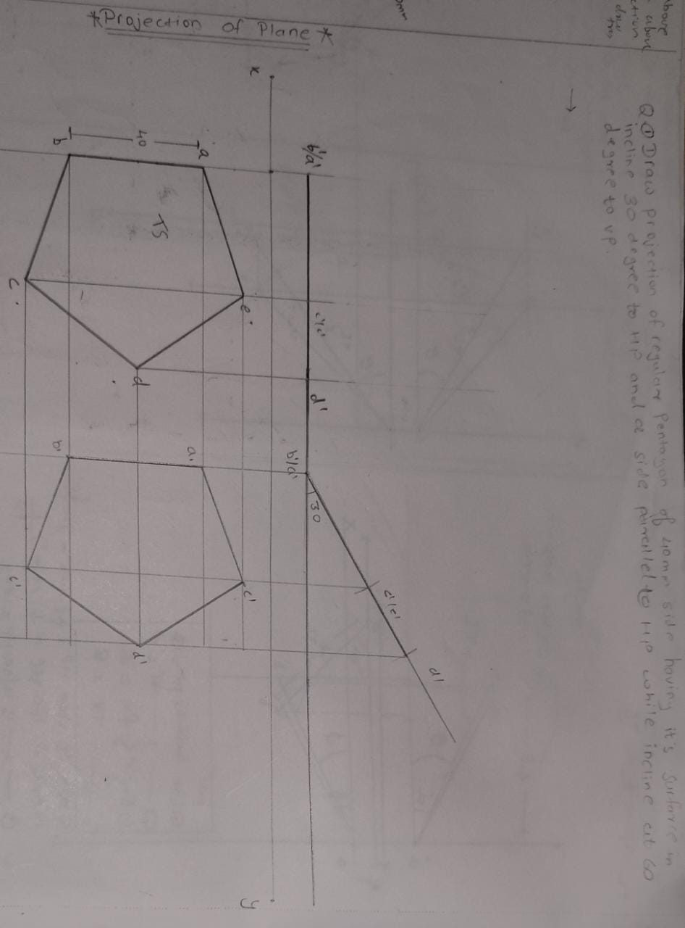

Slide 15
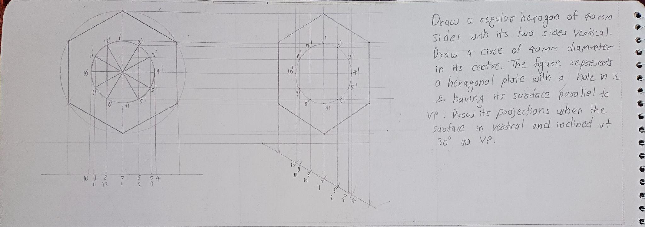

Slide 16
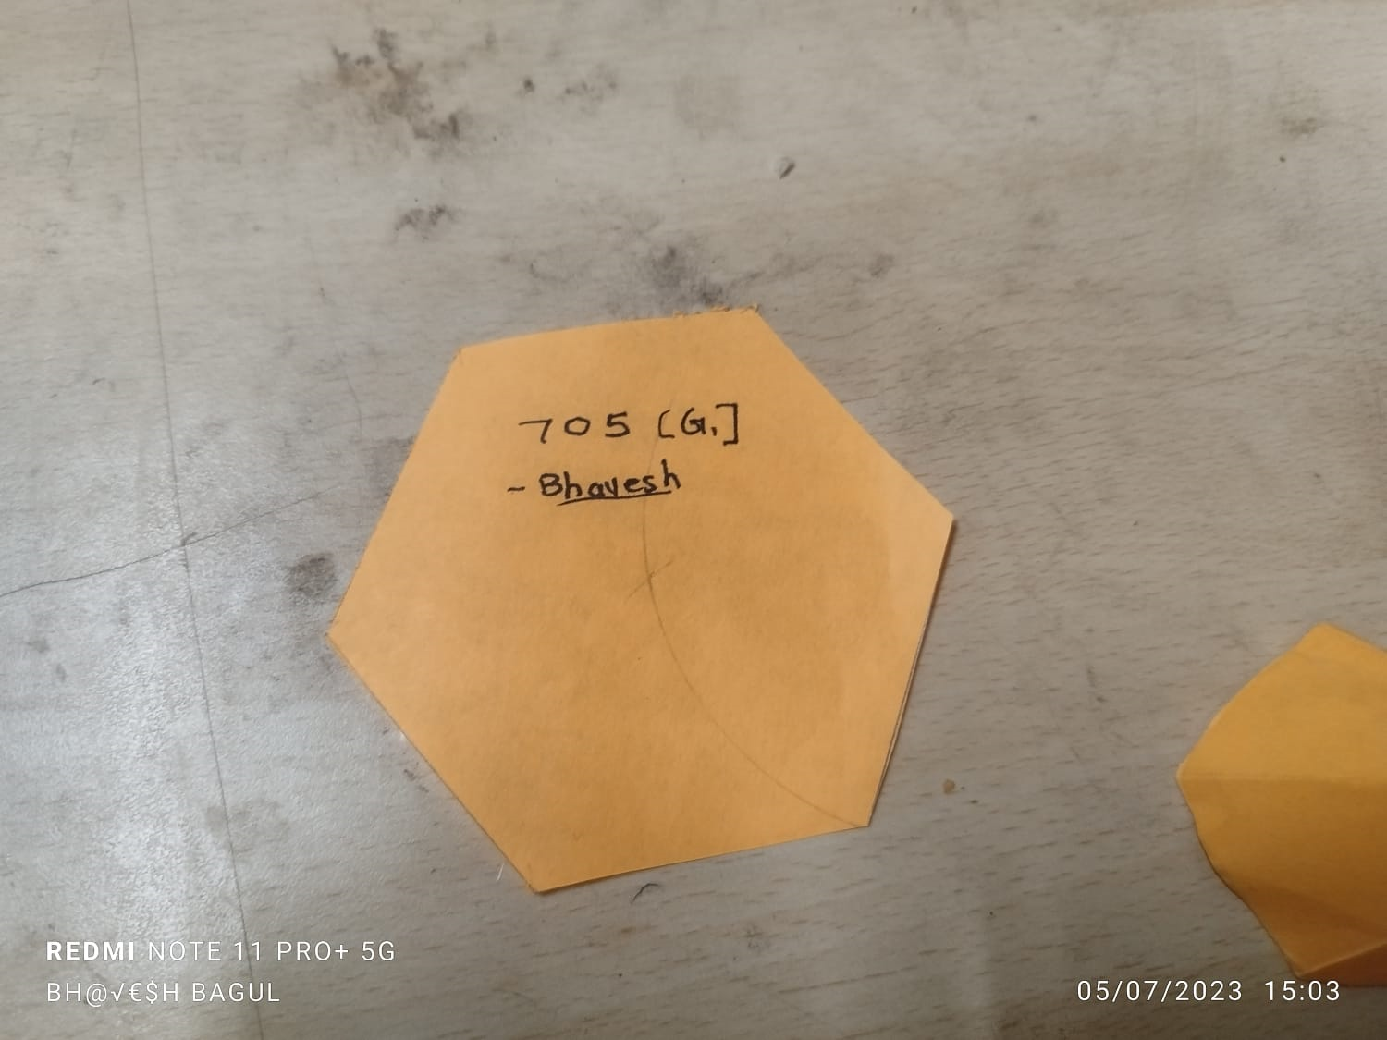
Activity carried under above Module
Plane Making

Slide 17
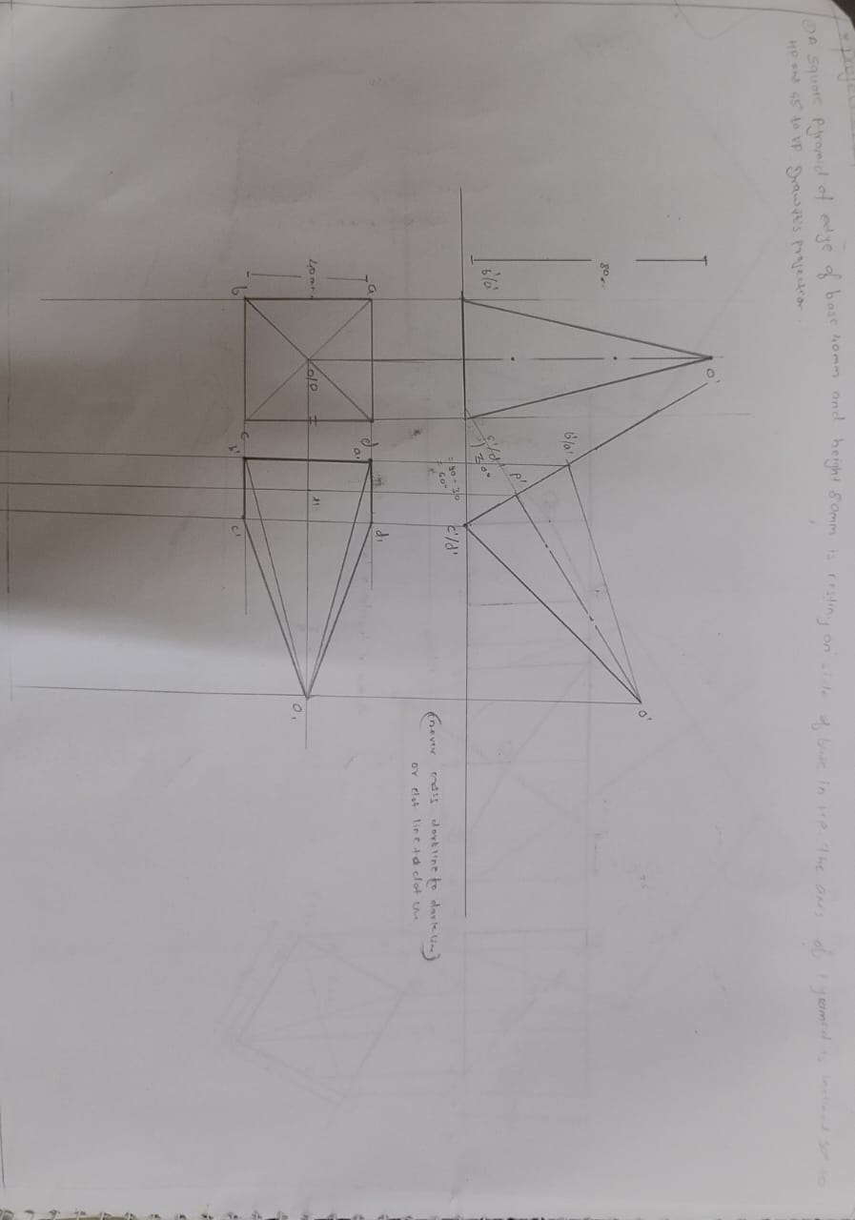
MODULE 4 Projection of Solids

Slide 18
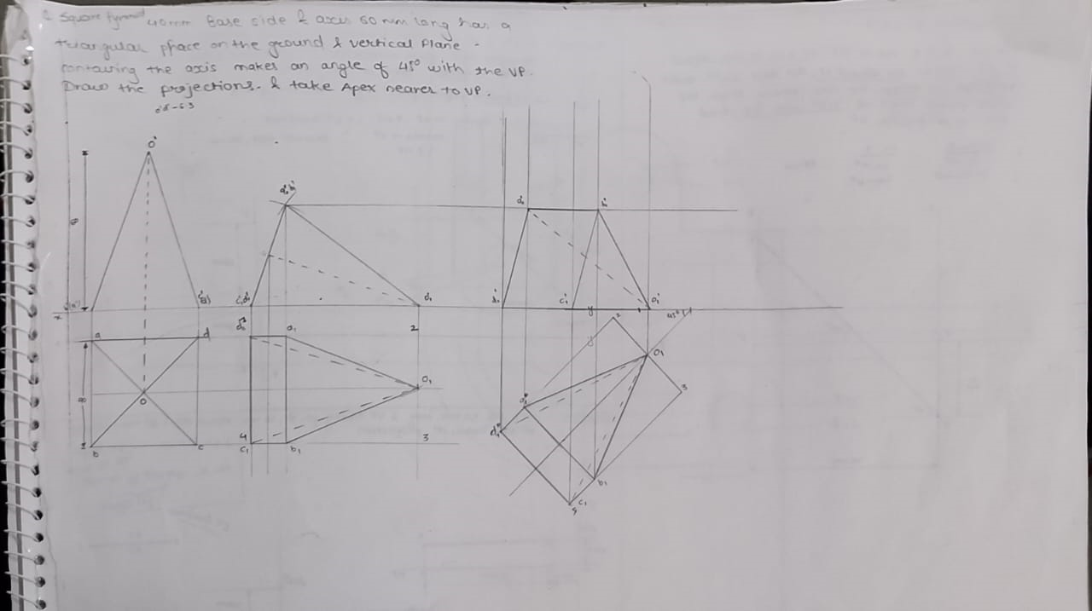

Slide 19
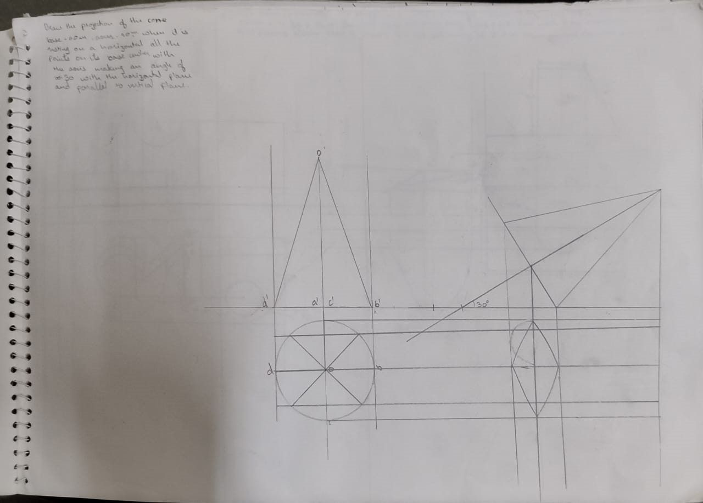

Slide 20
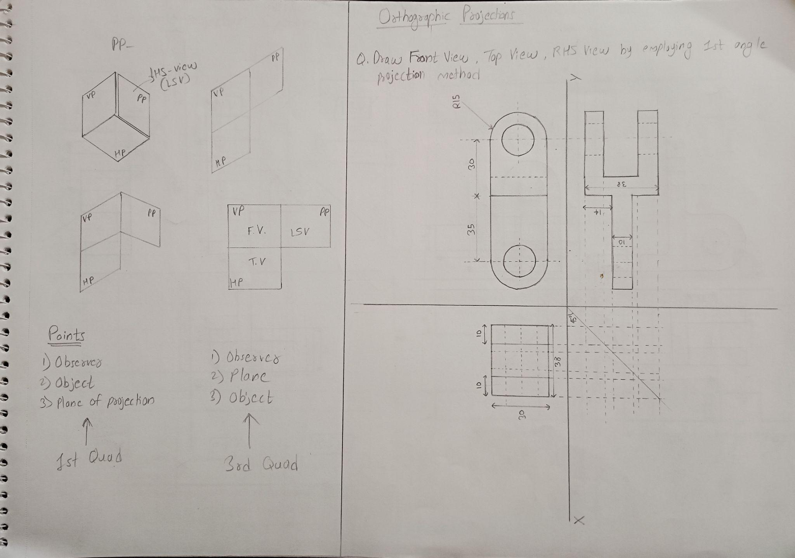
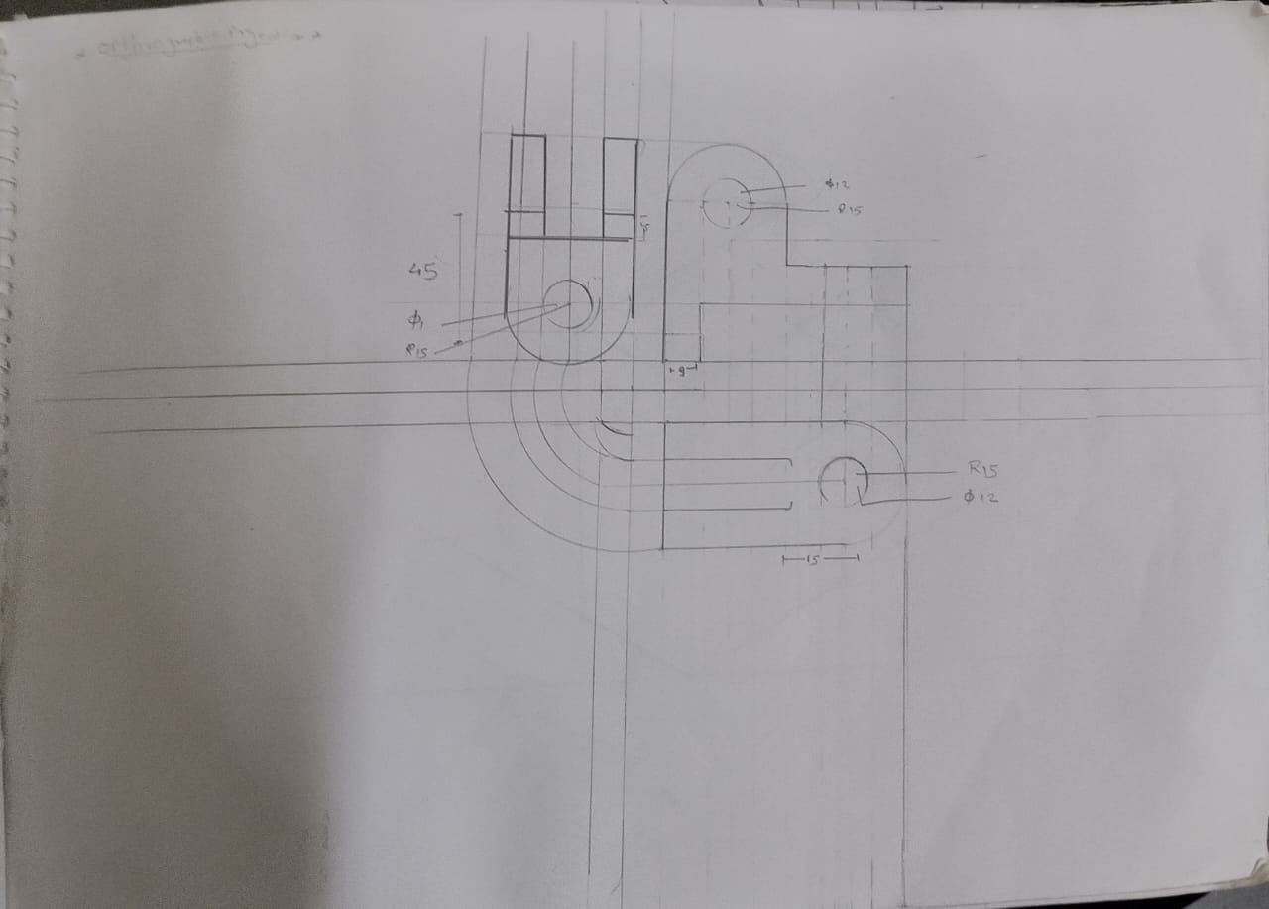
MODULE 5 Orthographic Projections and Sectional Views

Slide 21
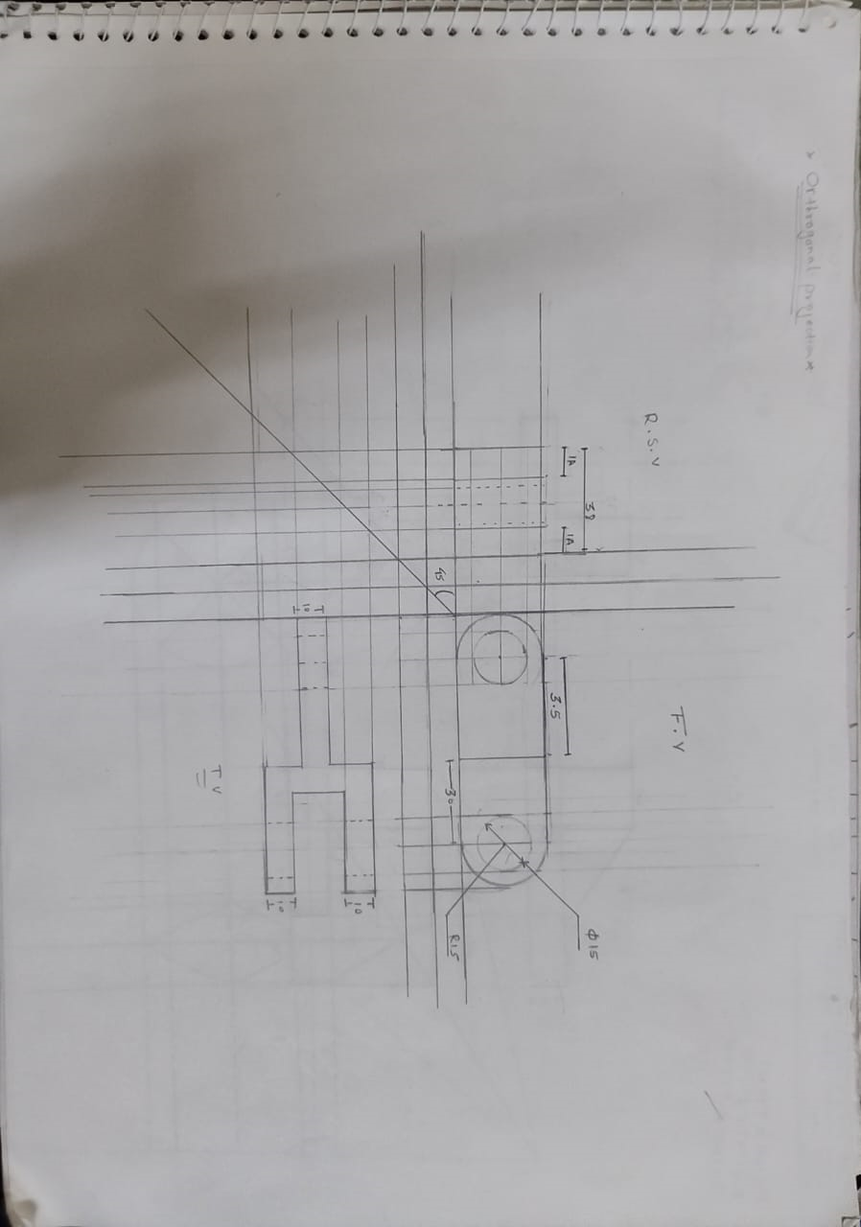
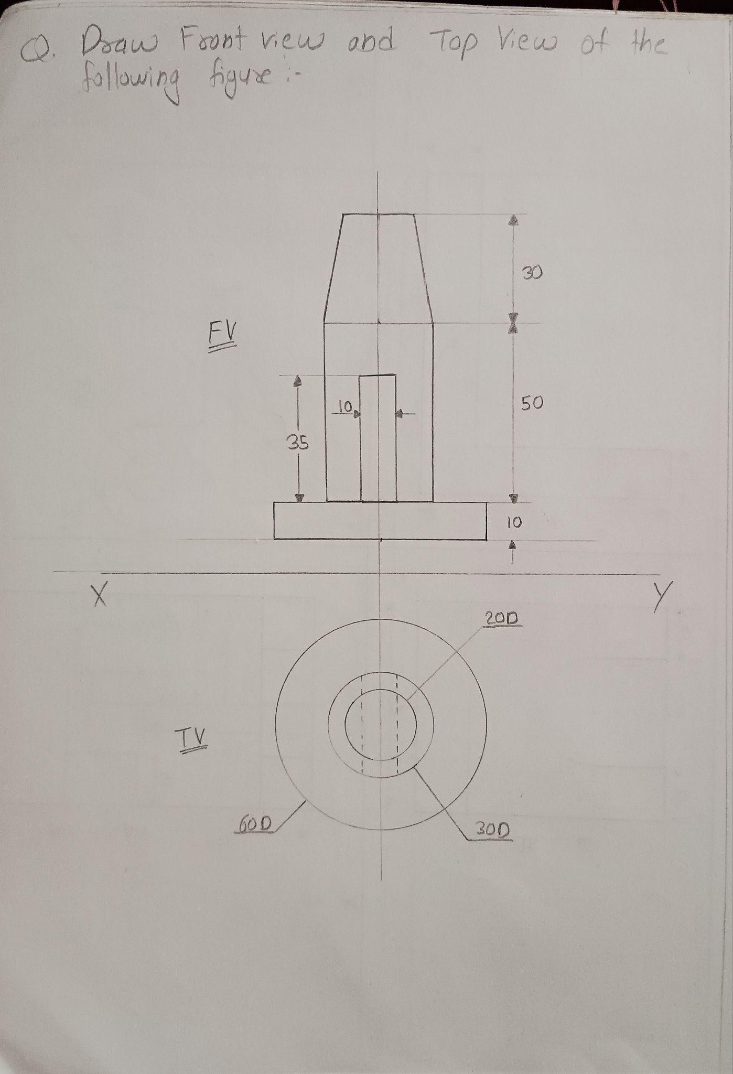

Slide 22
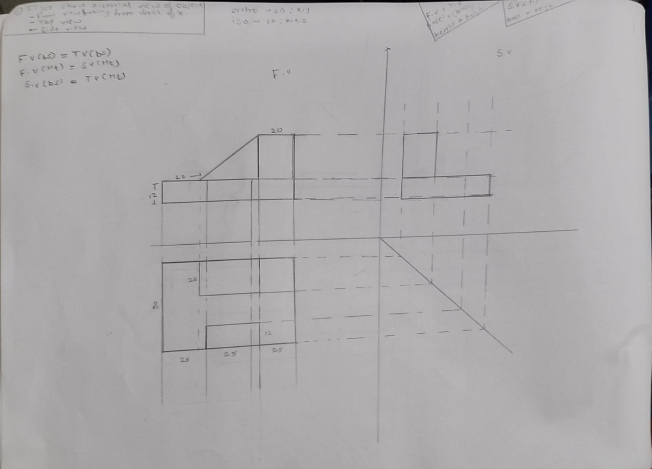

Slide 23
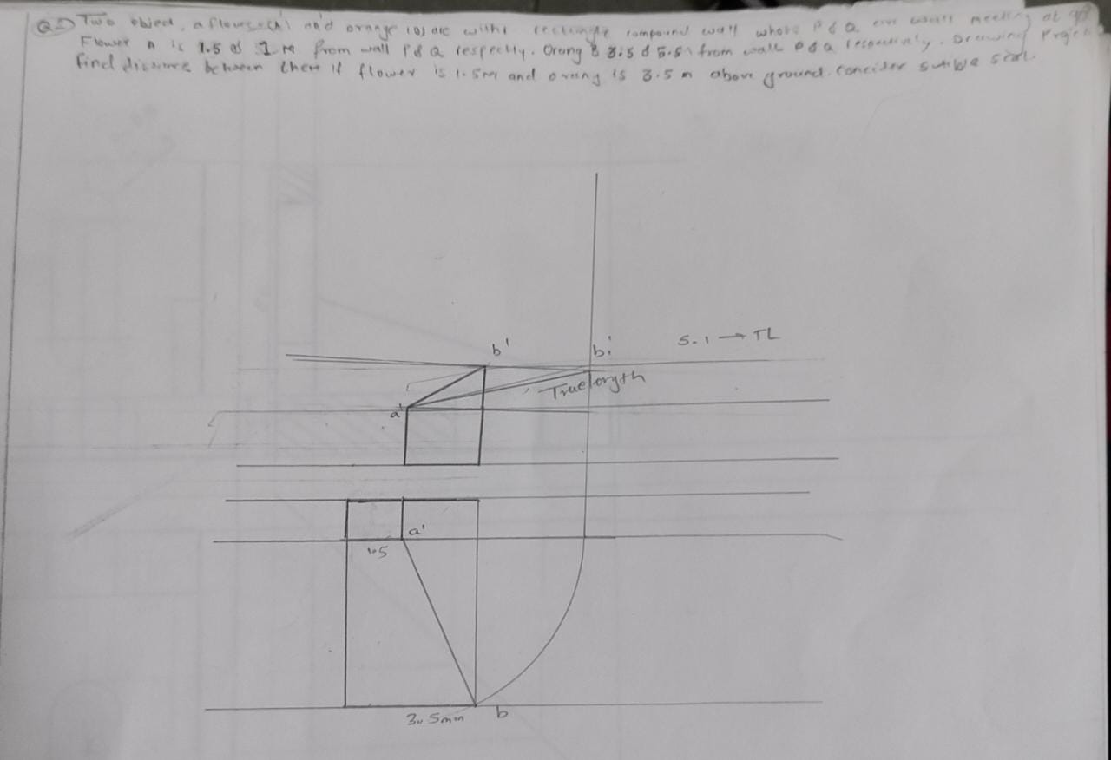

Slide 24
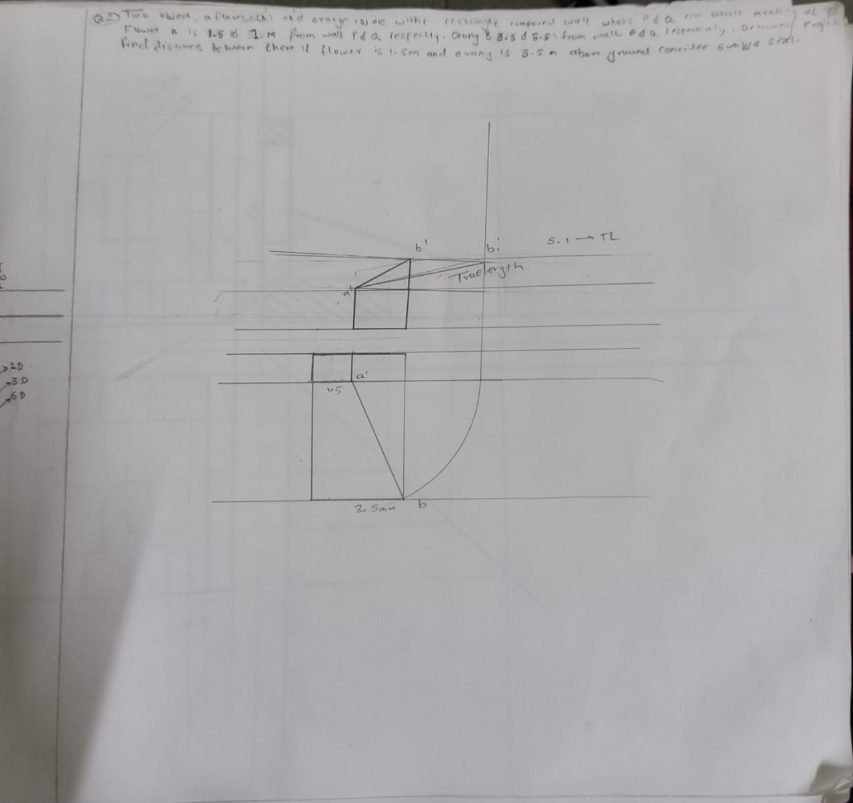

Slide 25
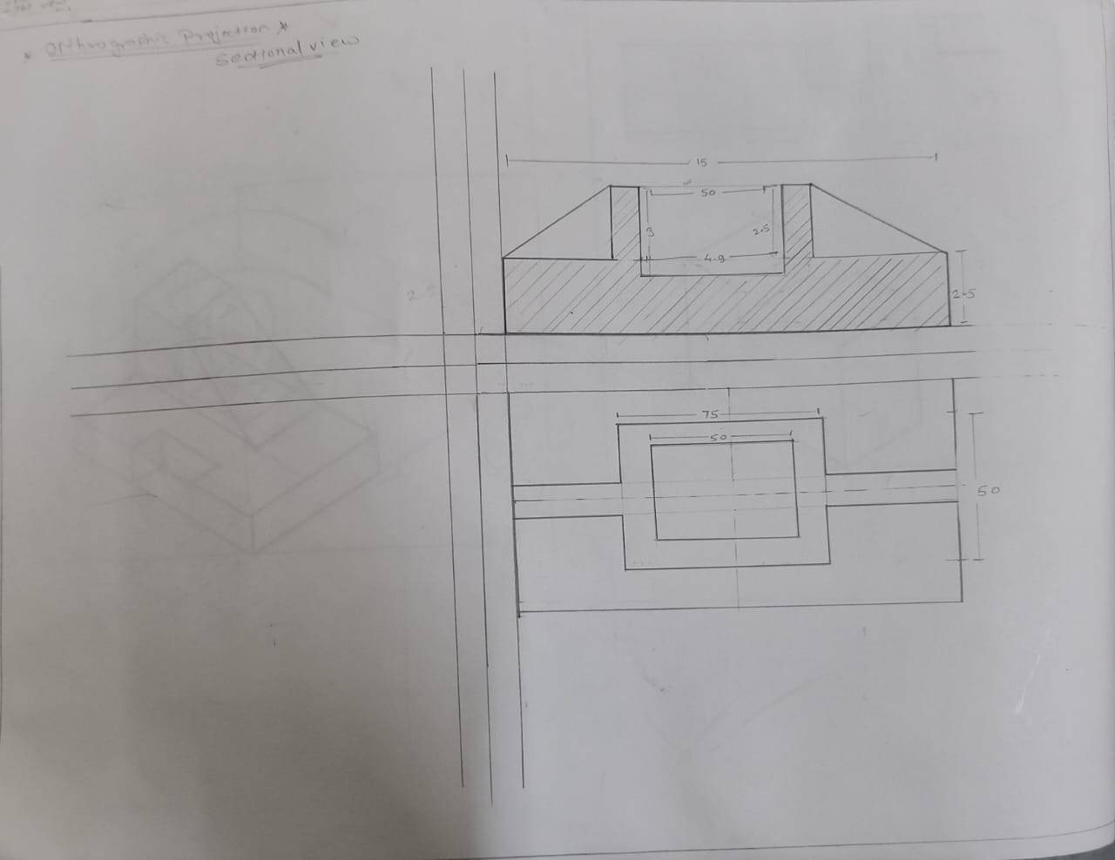
Sectional View

Slide 26
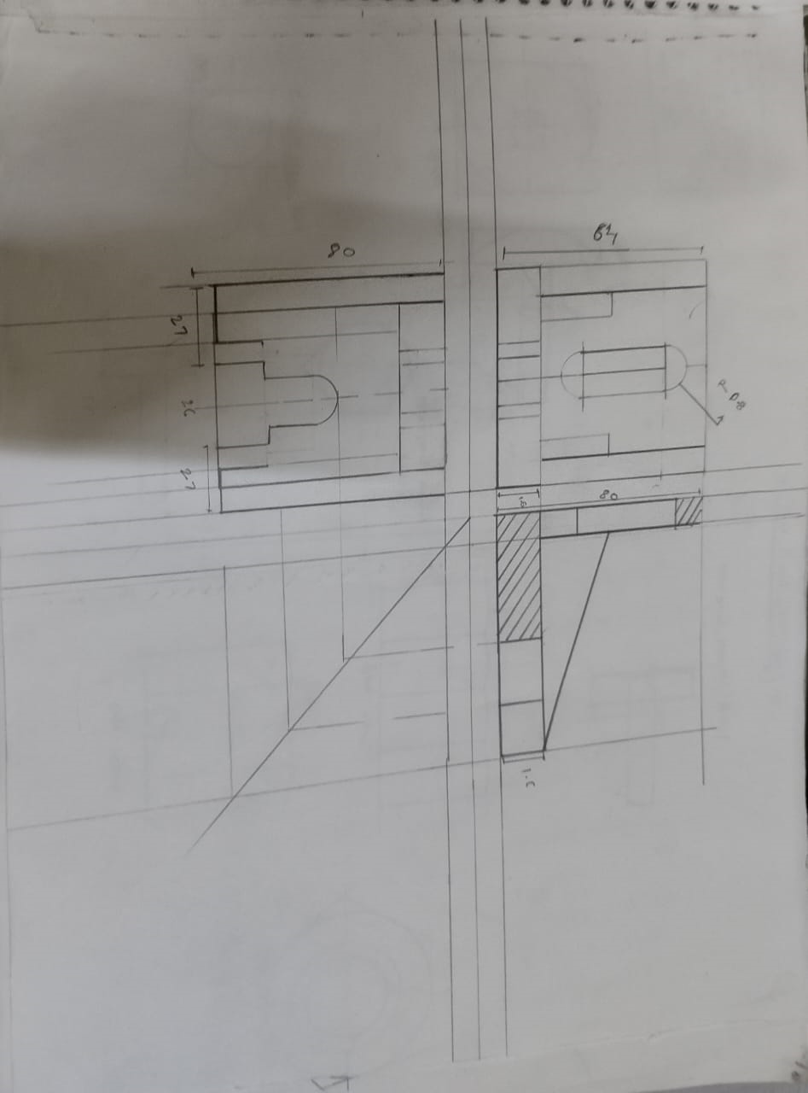

Slide 27
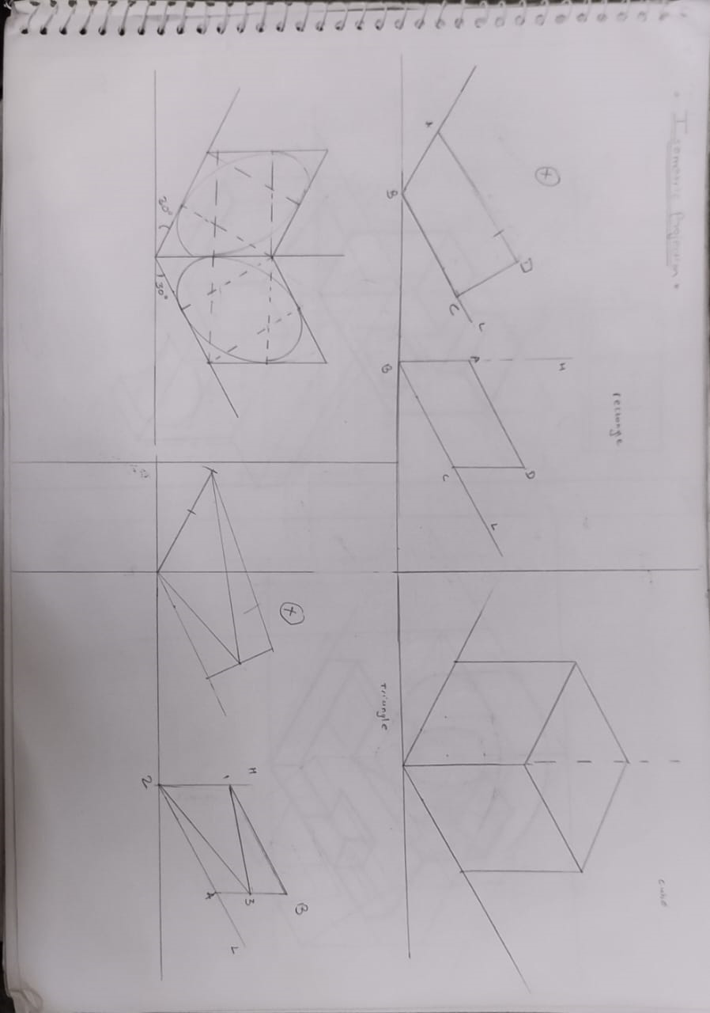
MODULE 6 Isometric Projection

Slide 28
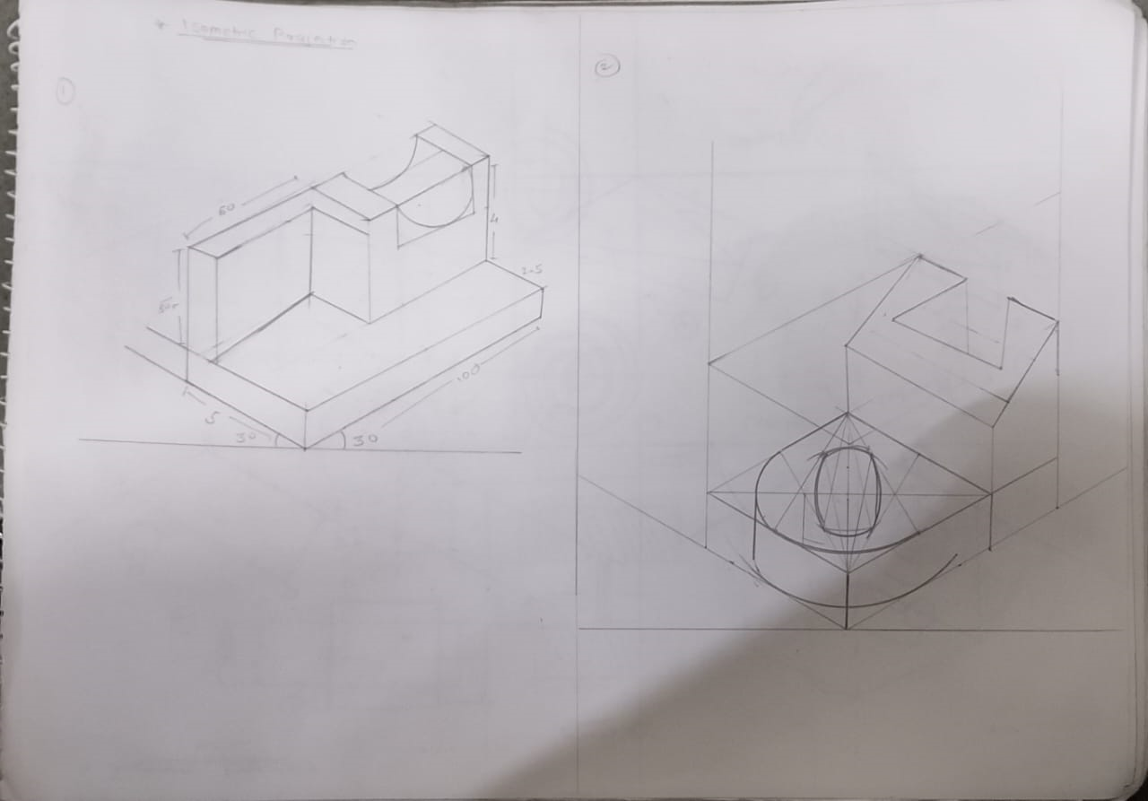

Slide 29
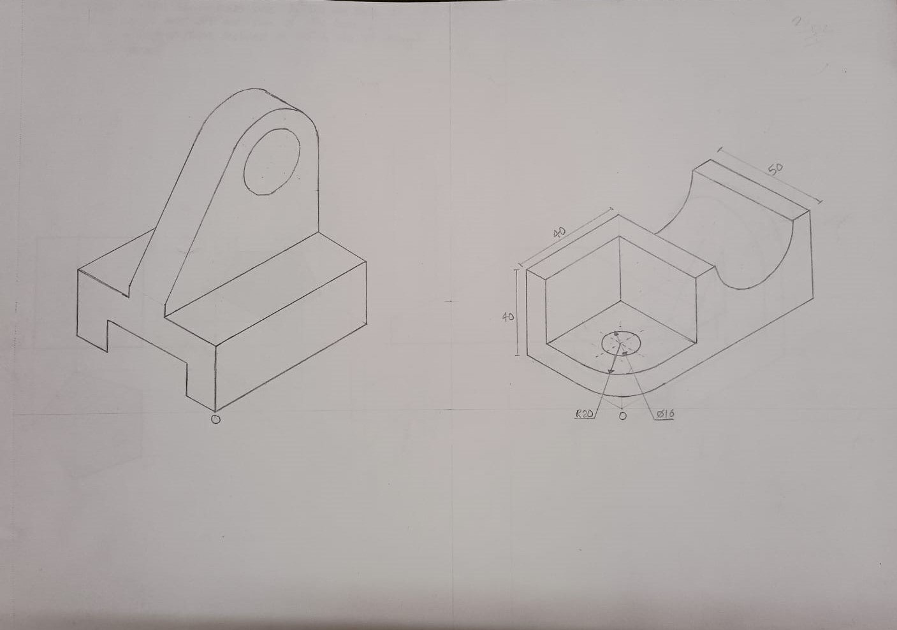
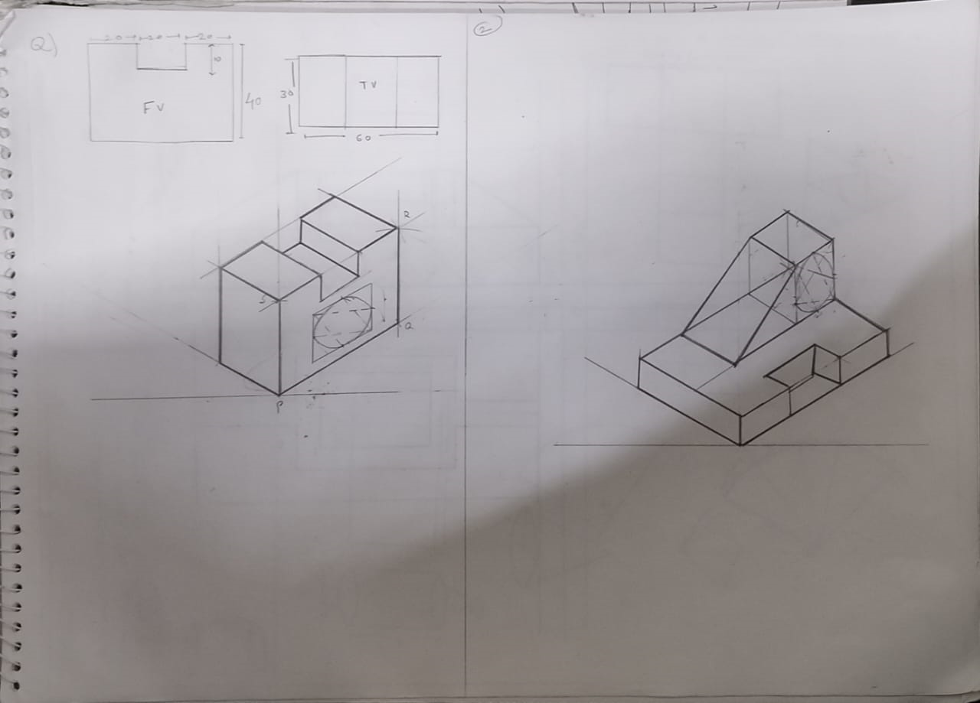

Slide 30
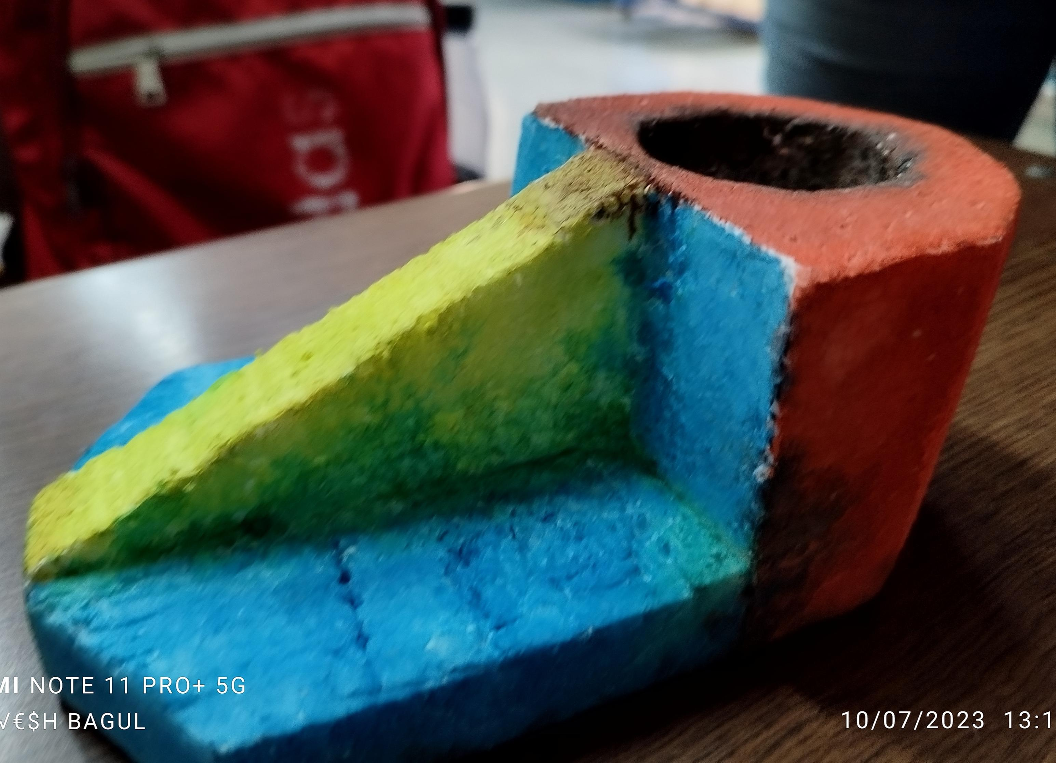
ISOMETRIC MODEL

Slide 31
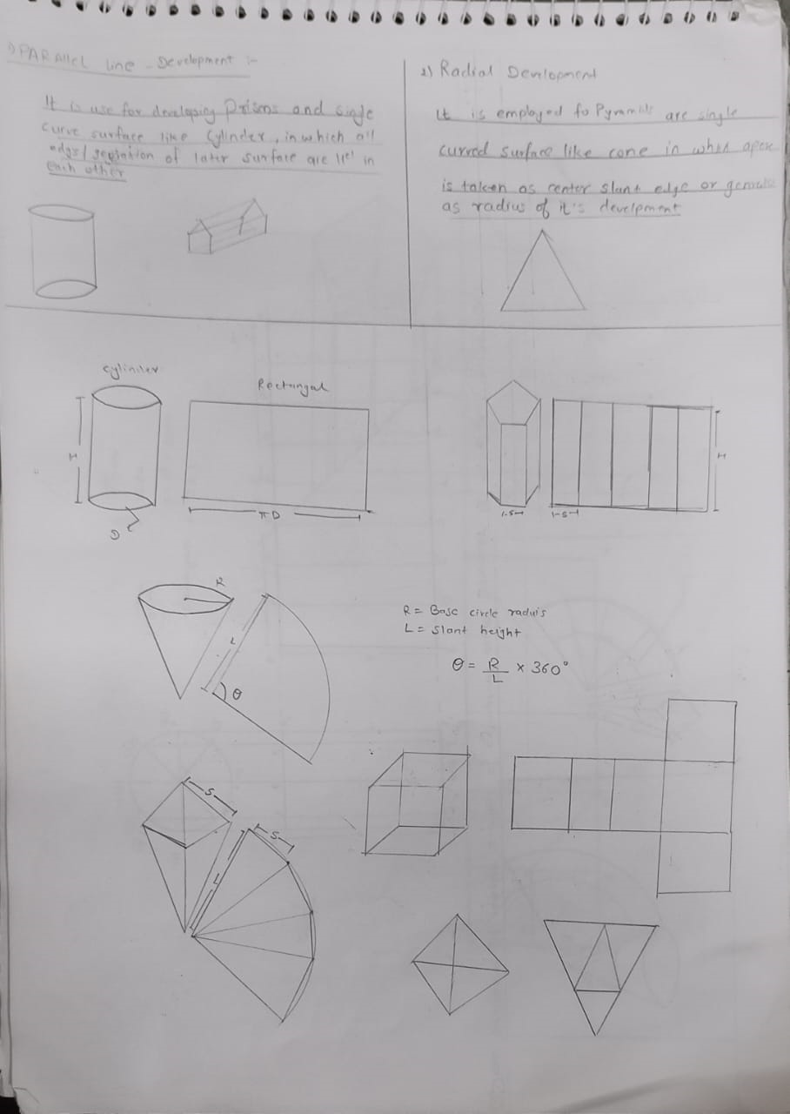
MODULE 7 Section of Solids and Development of Surfaces

Slide 32
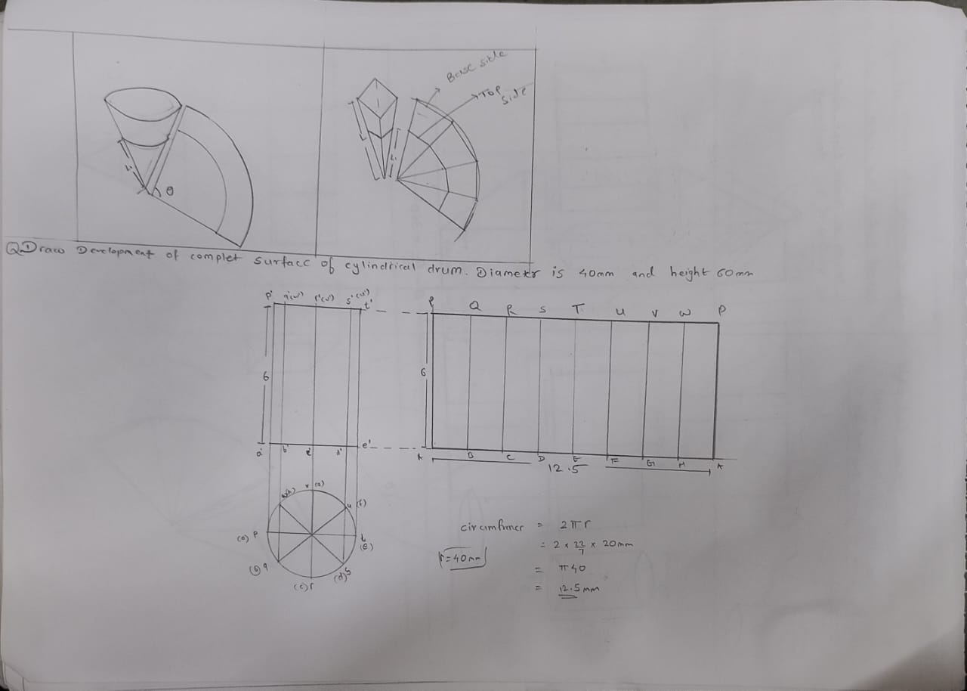

Slide 33
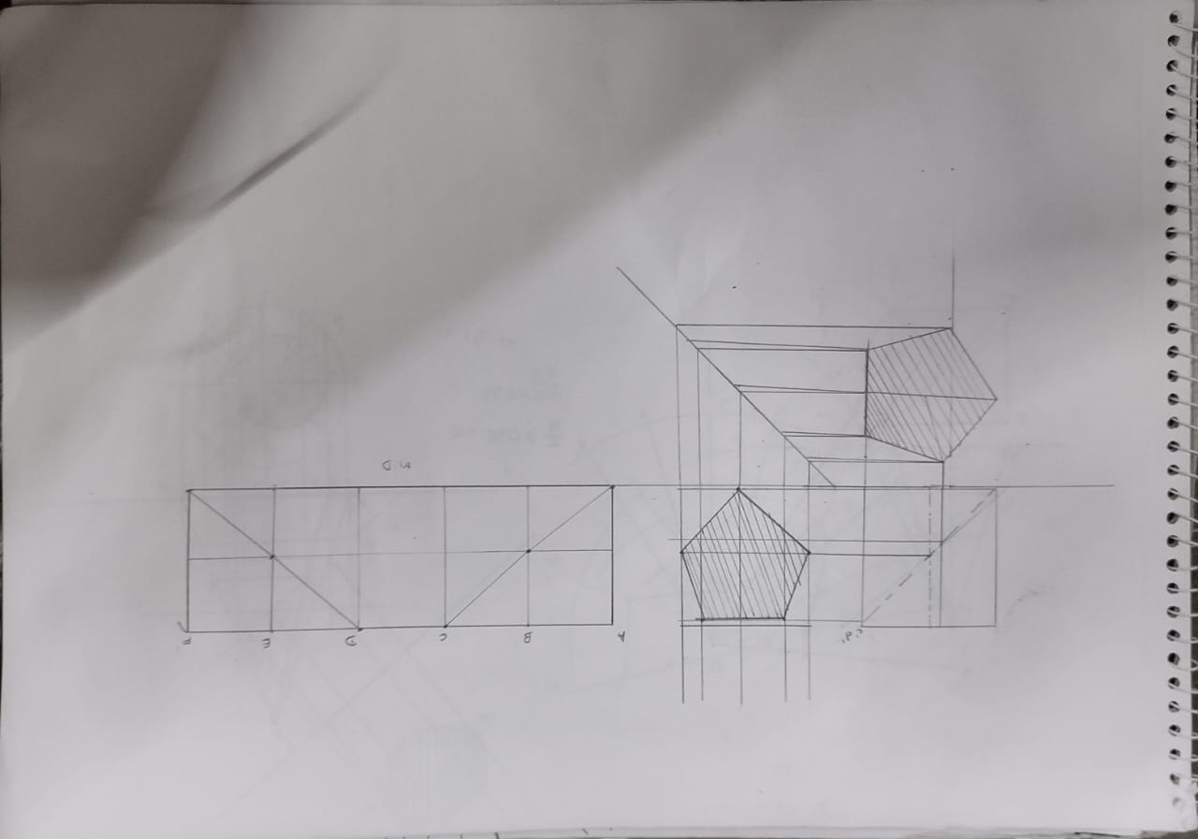

Slide 34
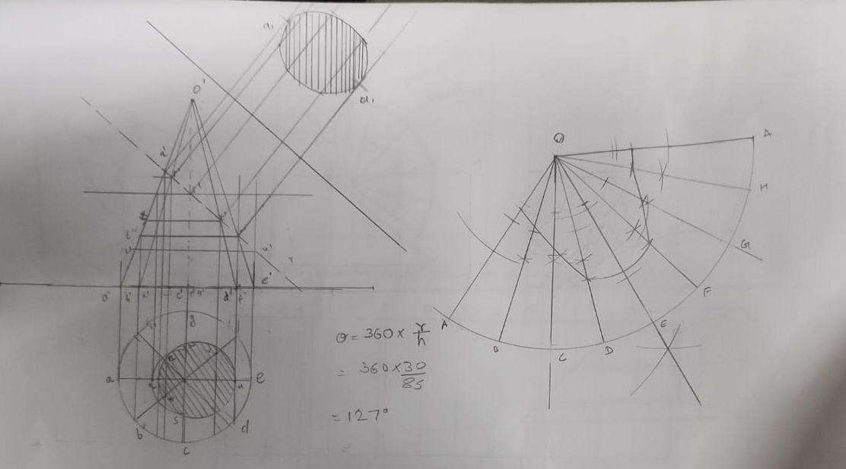

Slide 35
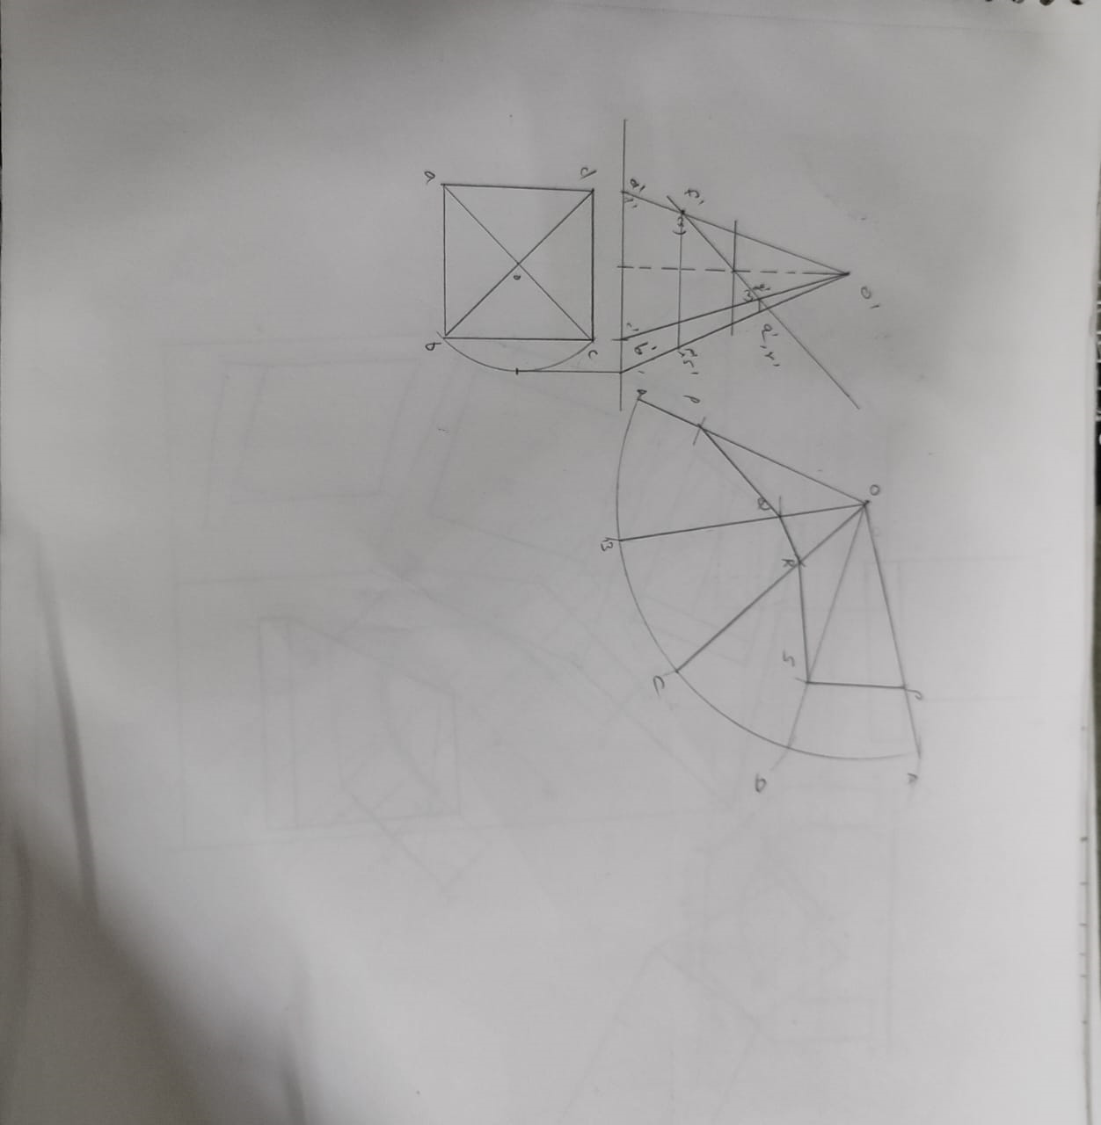
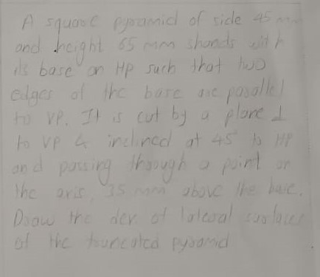

Slide 36
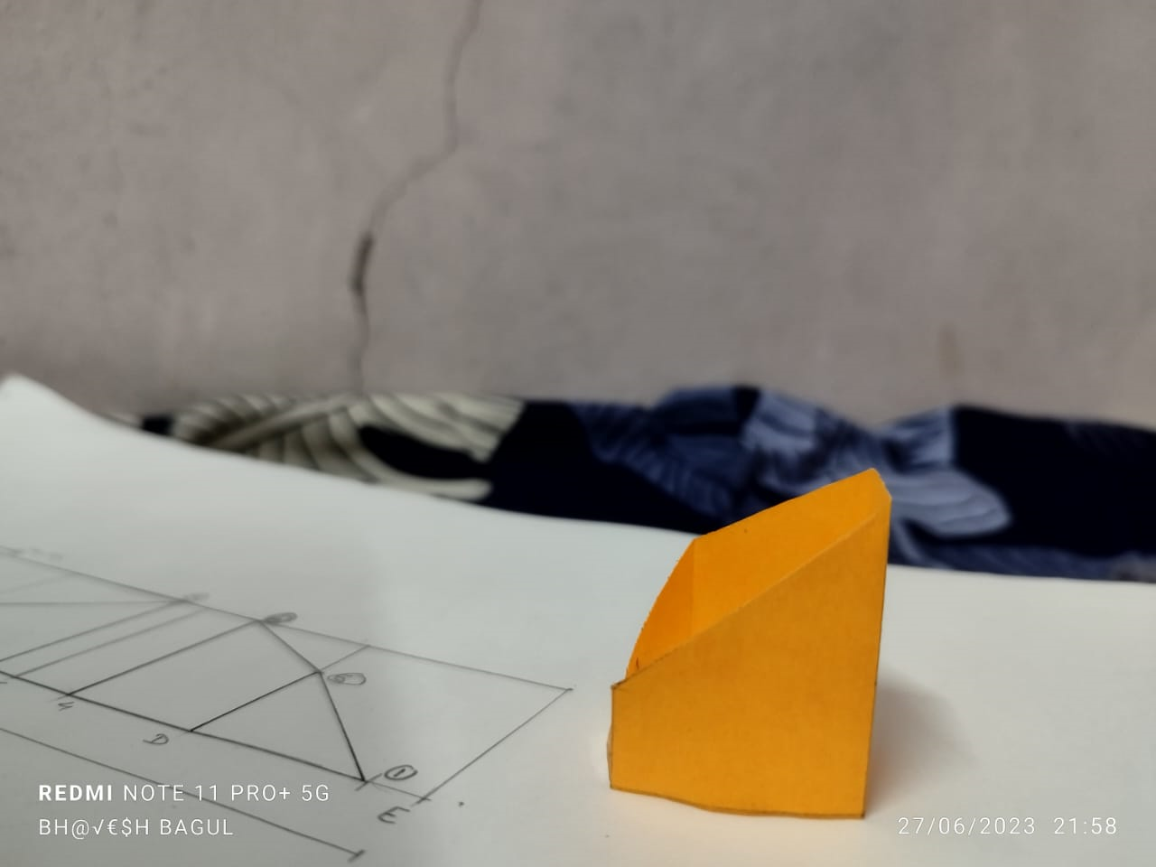
Activity carried under above Module

Slide 37
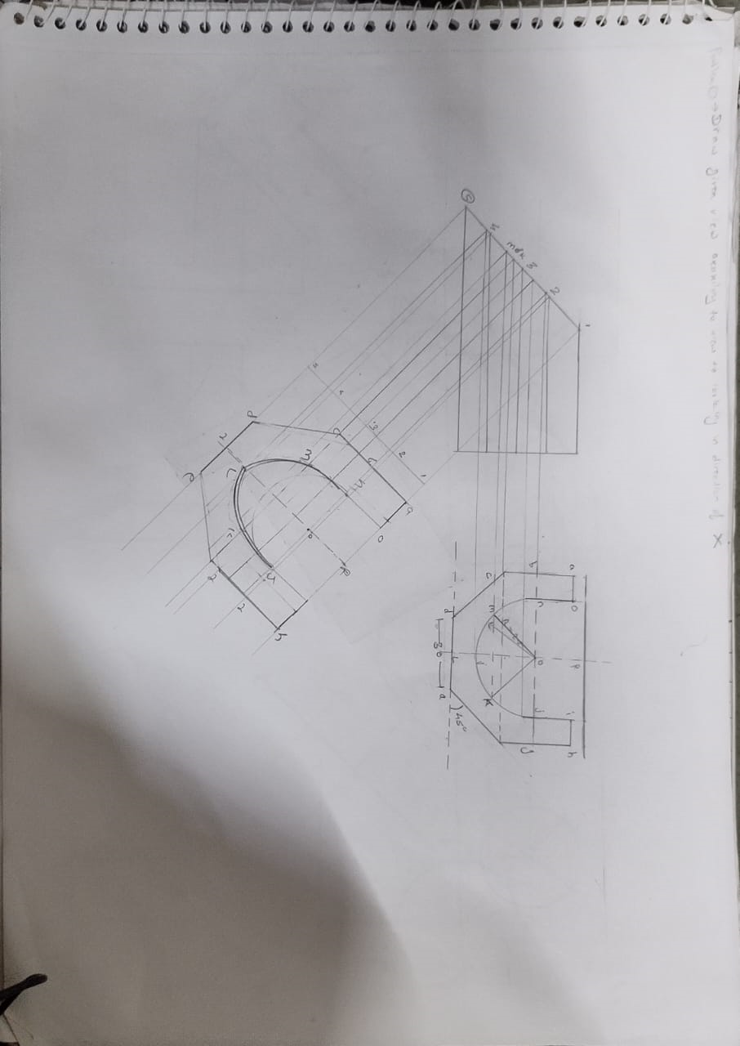
MODULE 8 Auxiliary Views

Slide 38
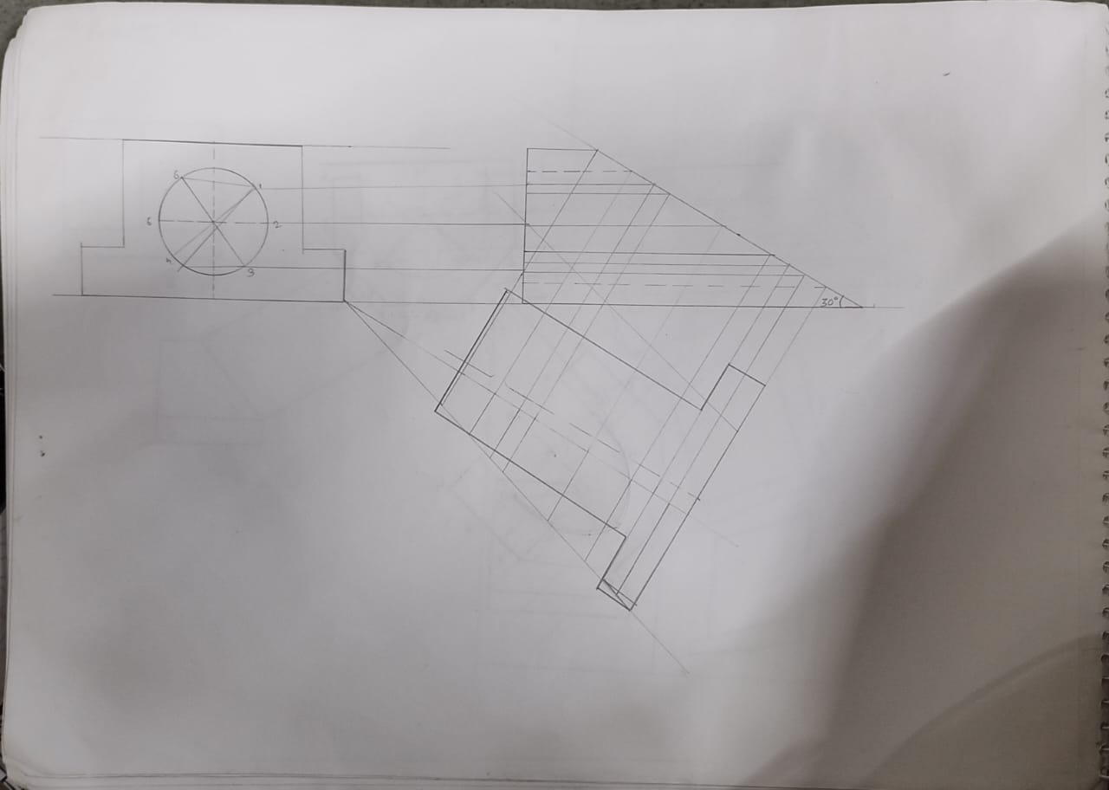

Slide 39
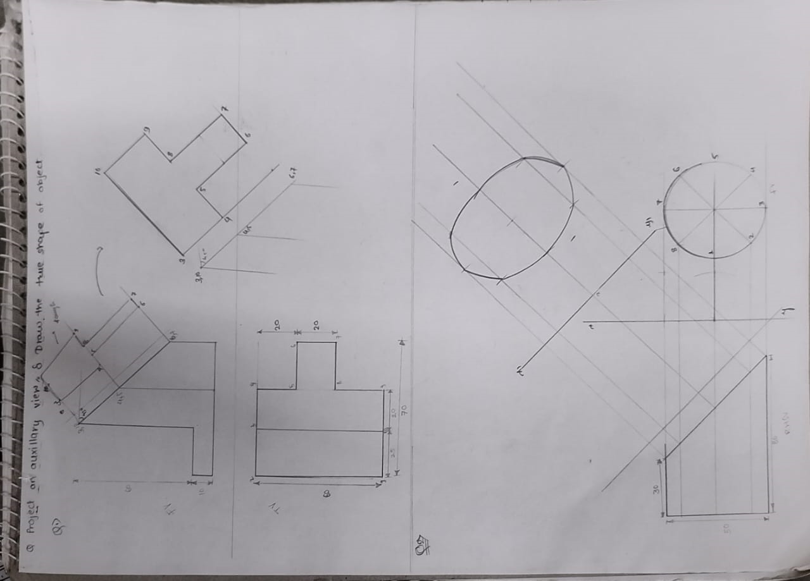

Slide 41
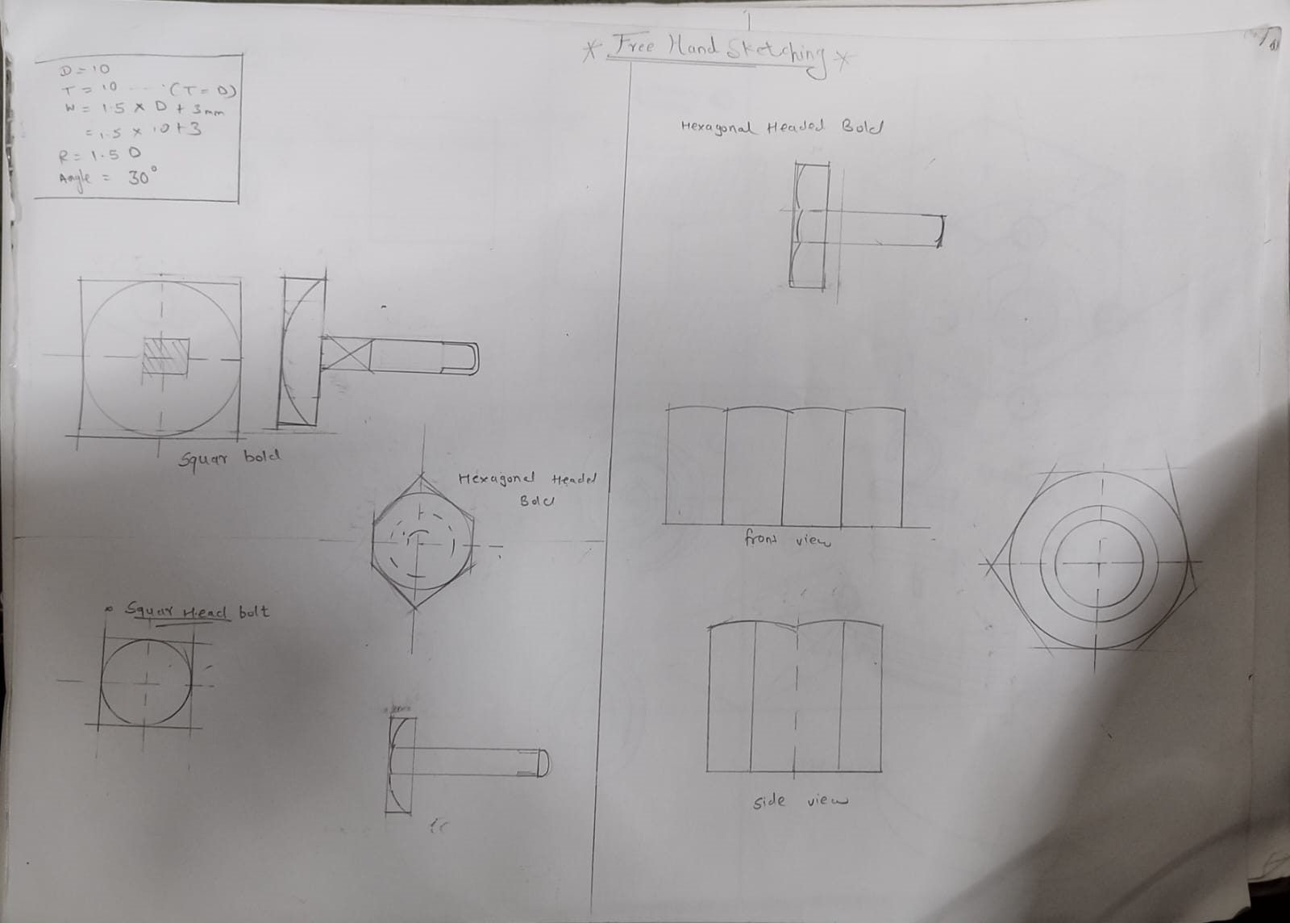
MODULE 9 Freehand Sketching

Slide 42
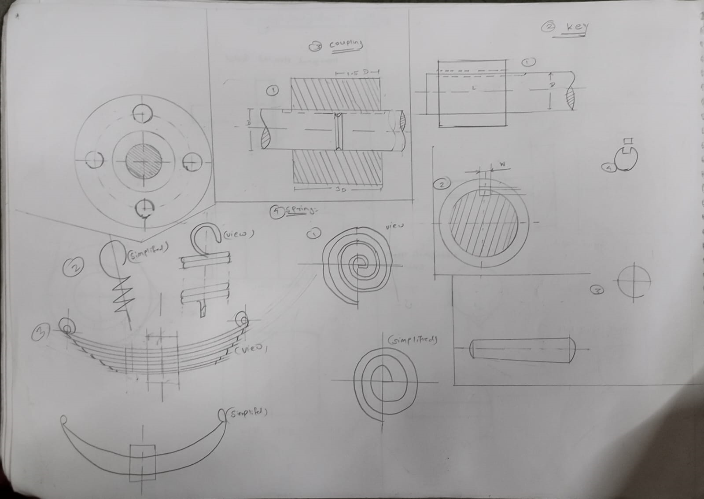

Slide 43
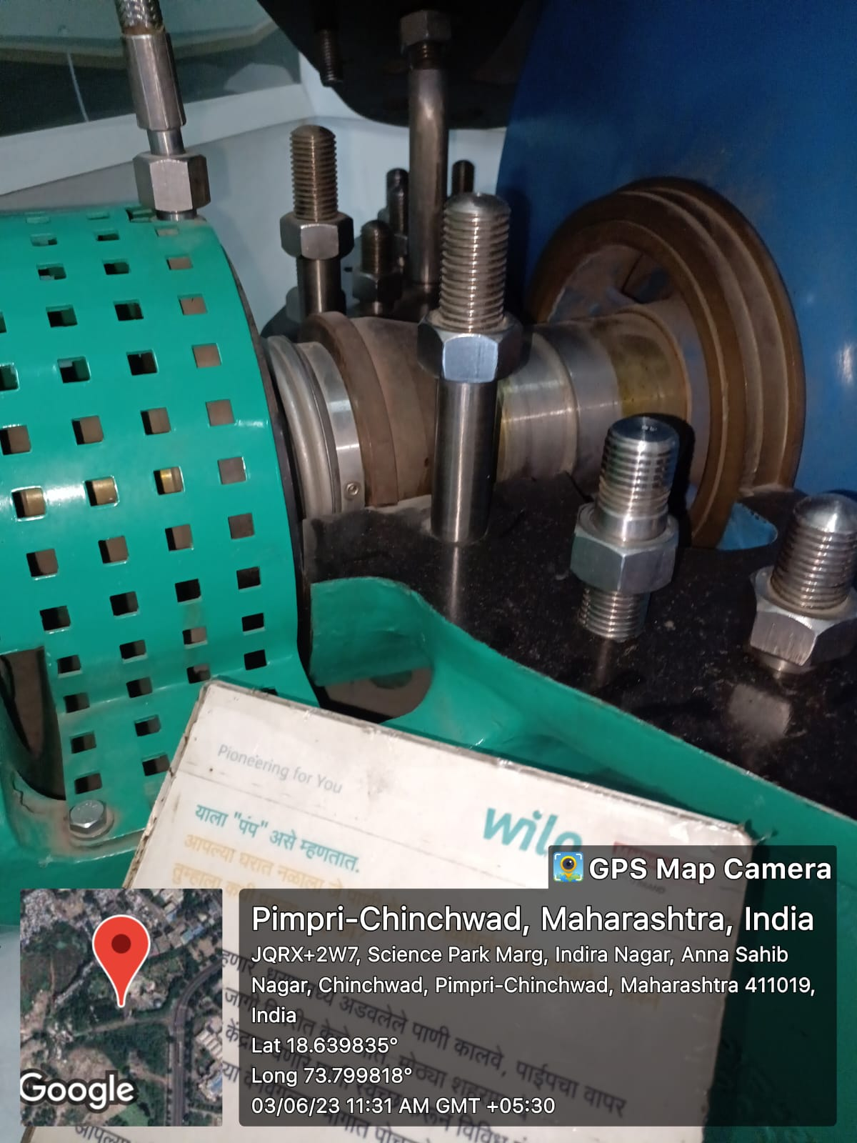
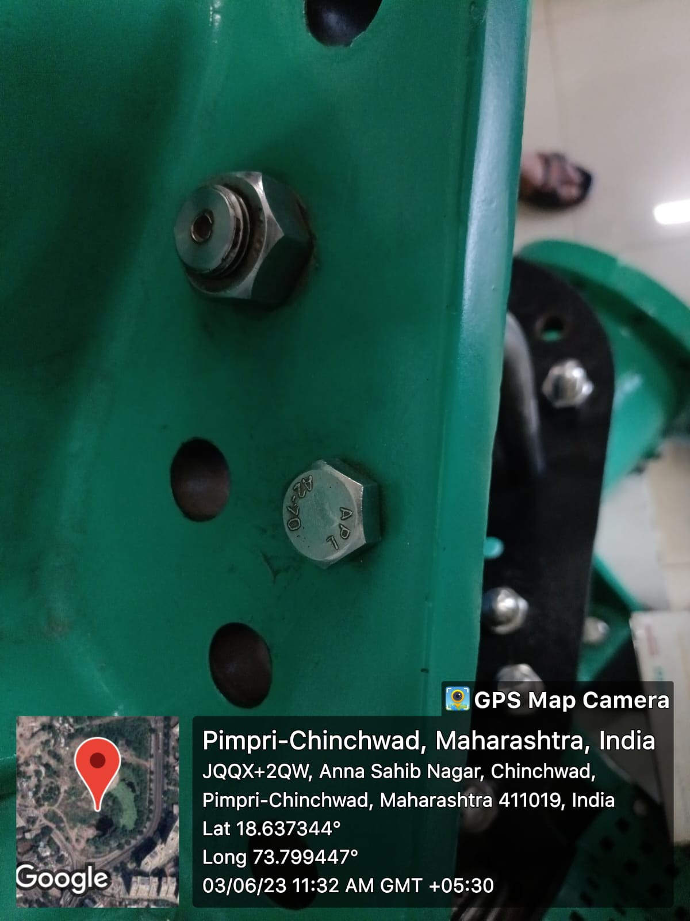
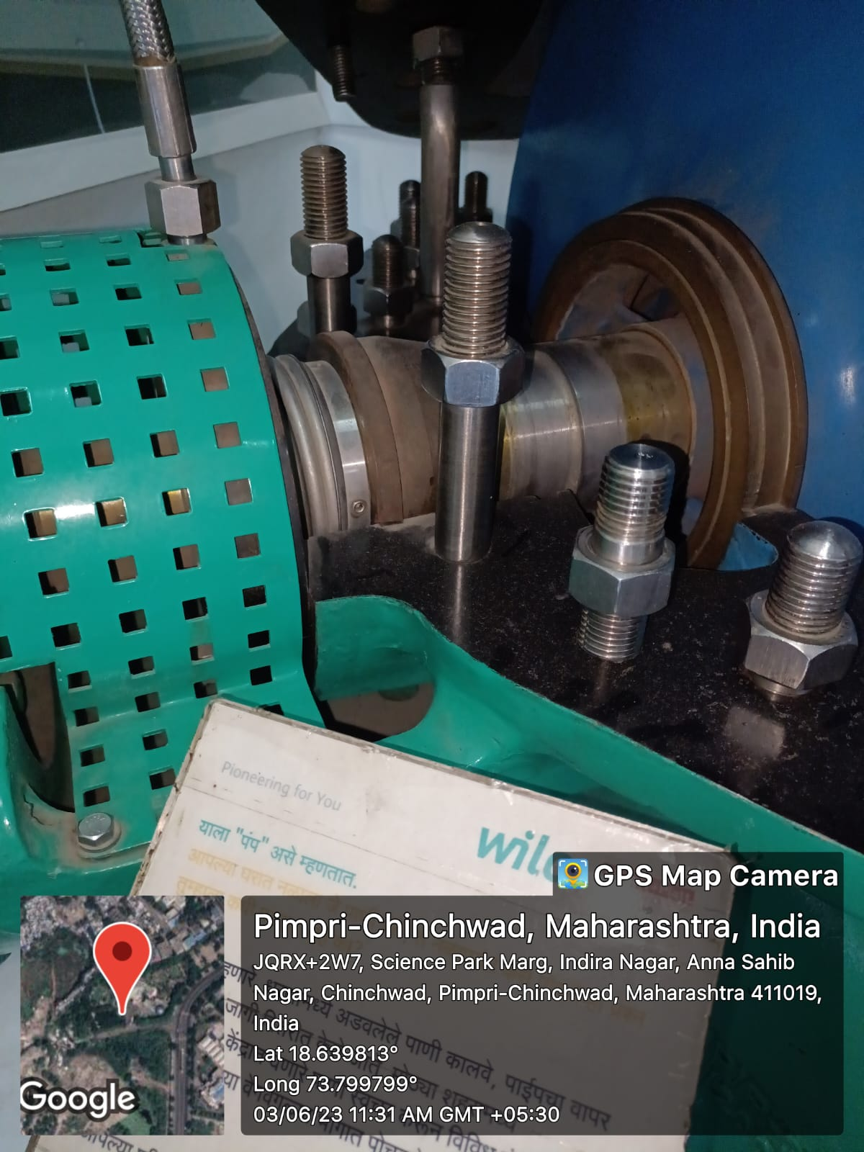
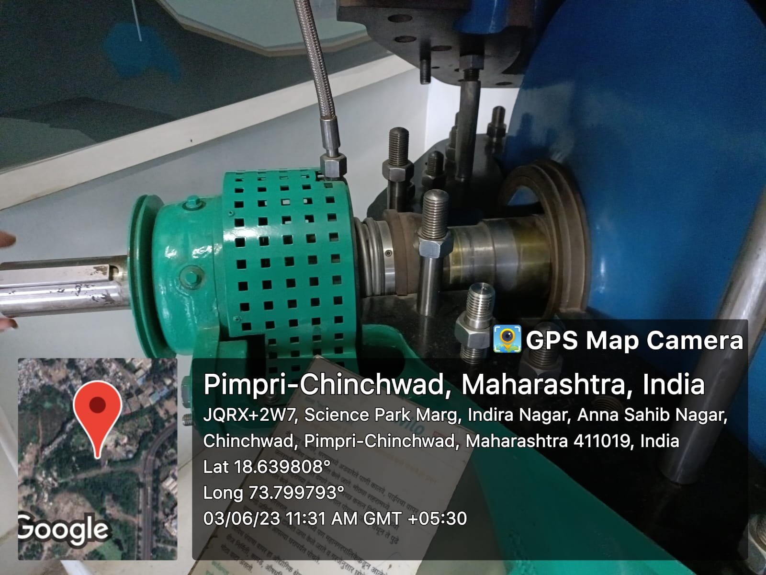
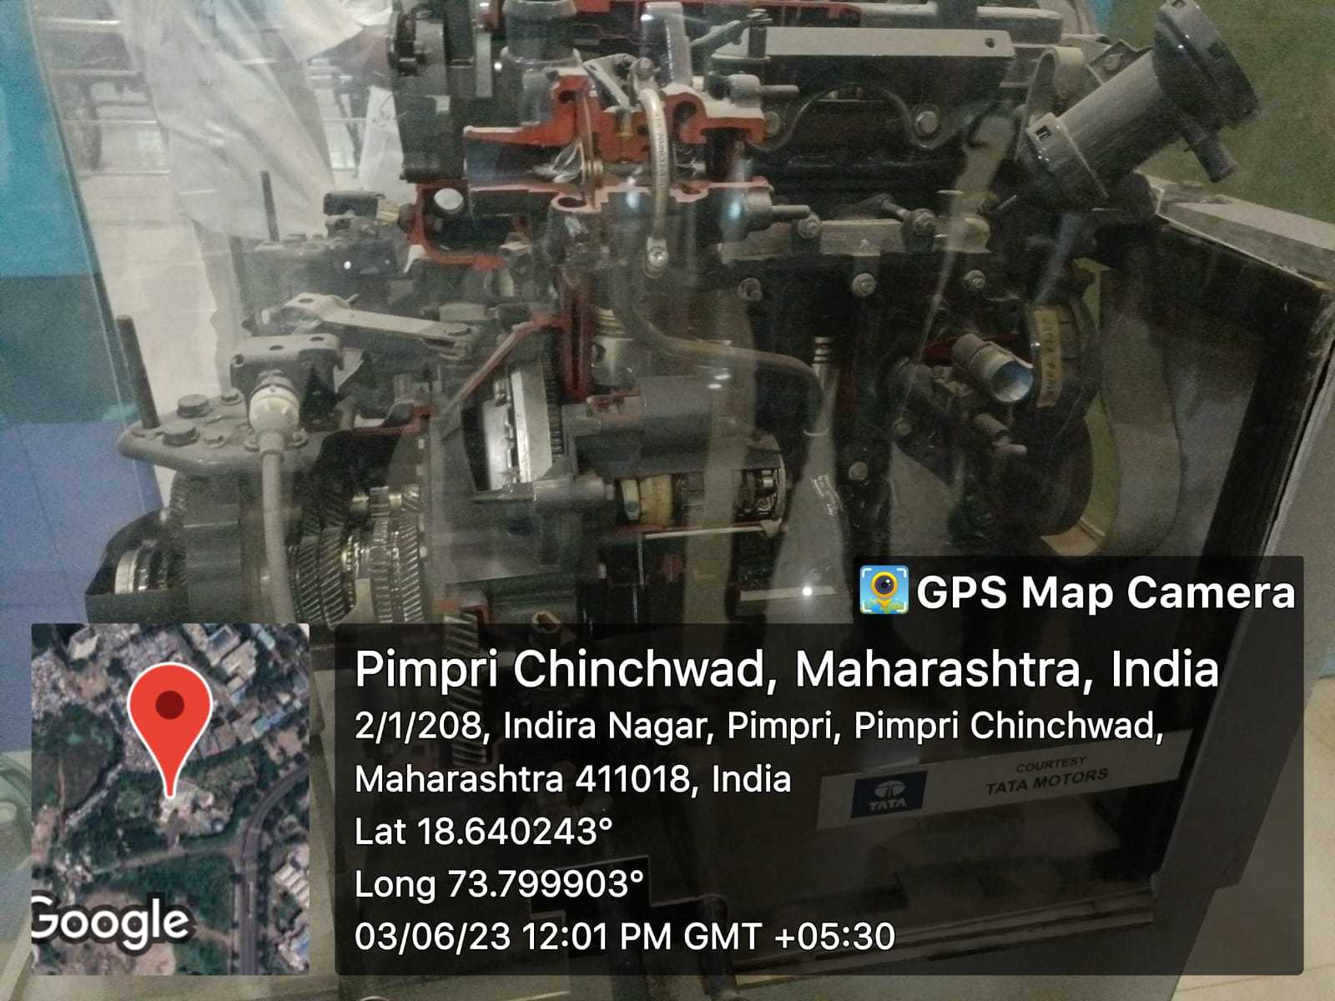
Science Park Project

Slide 44
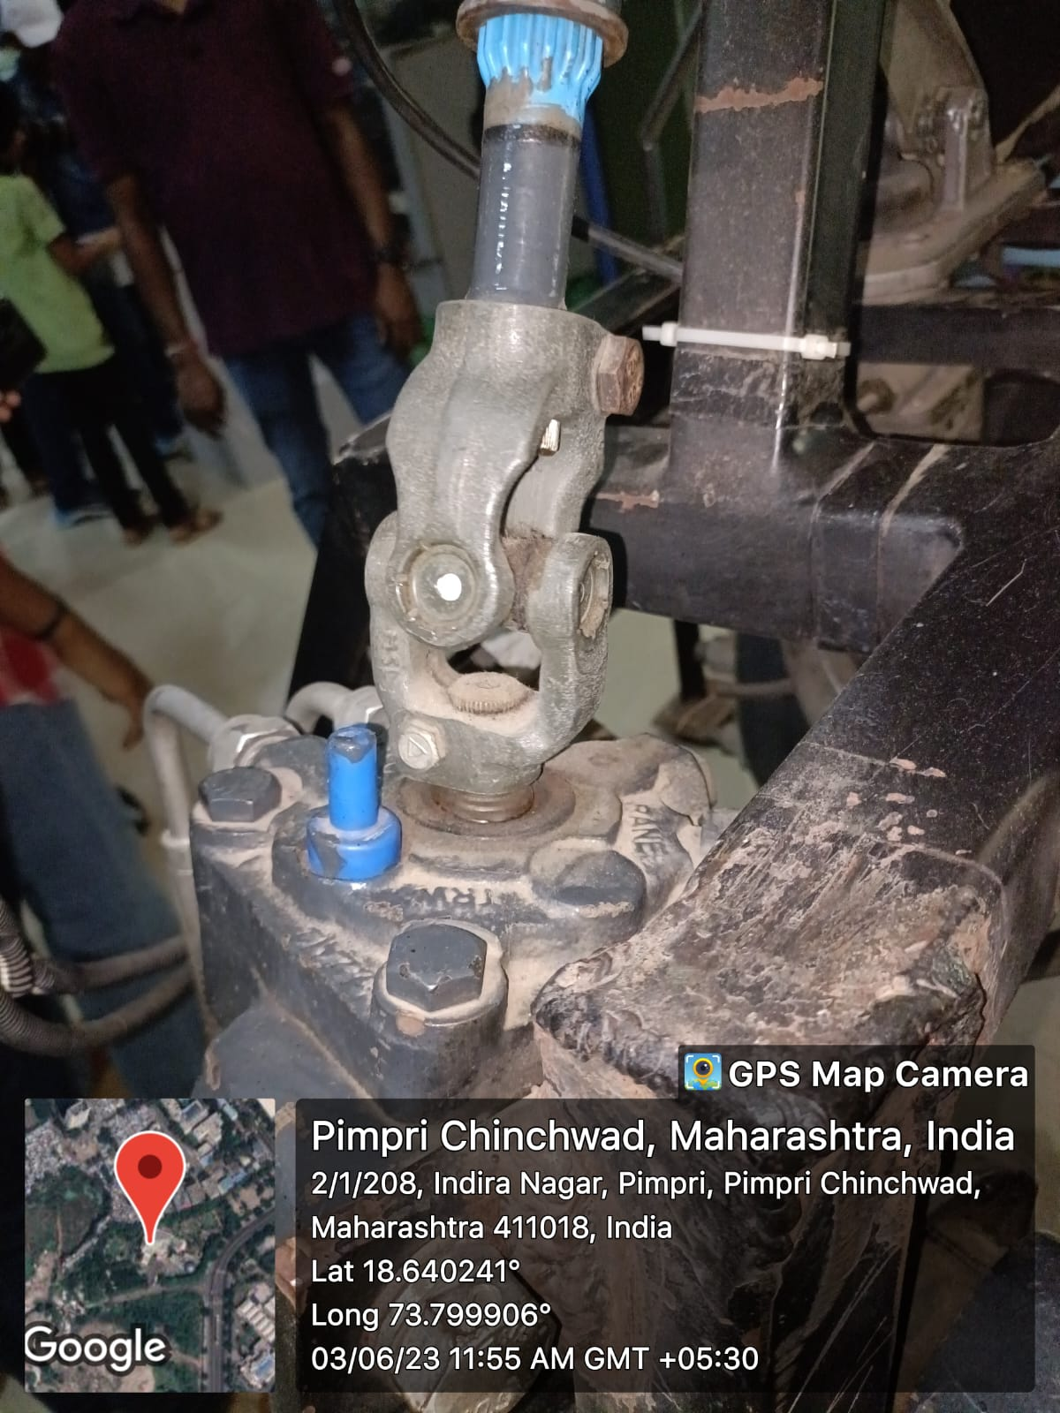
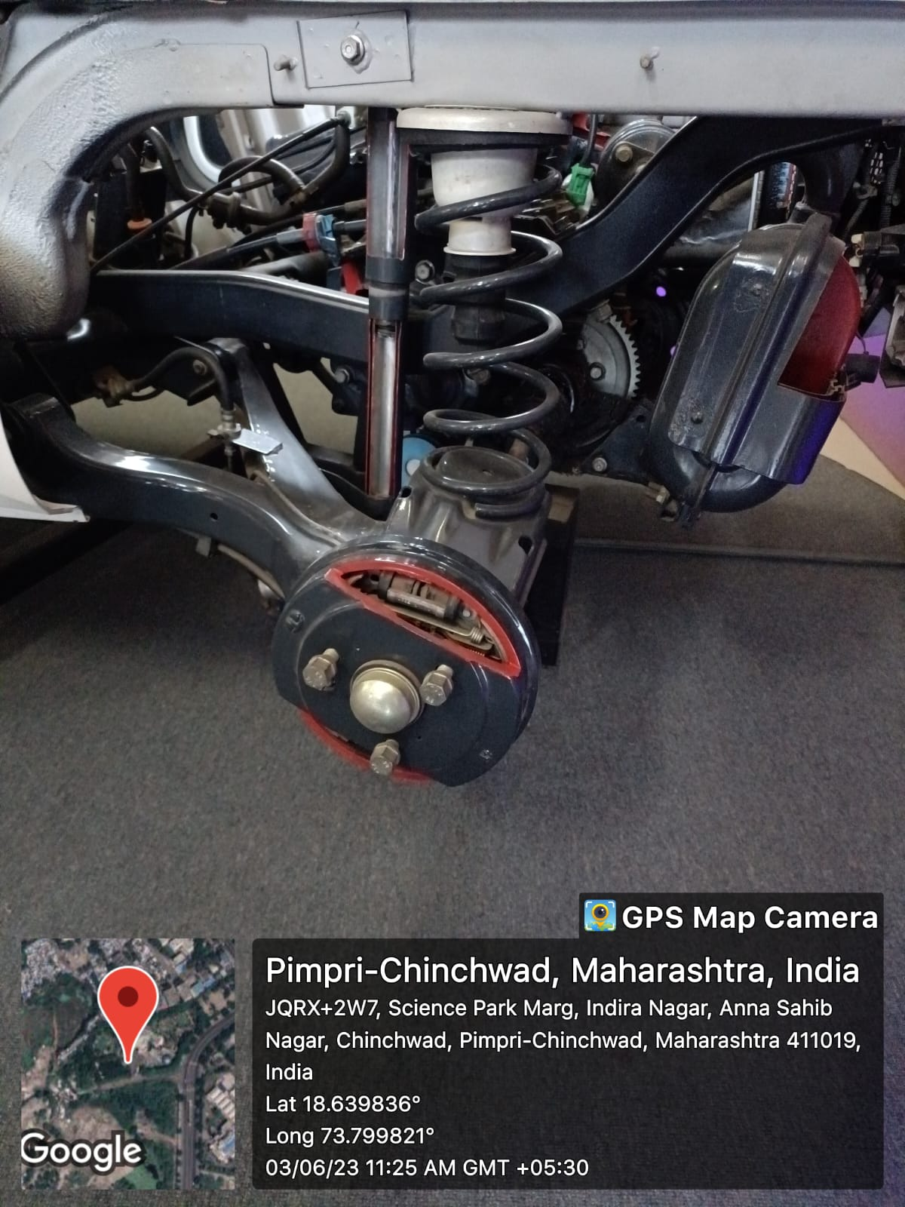
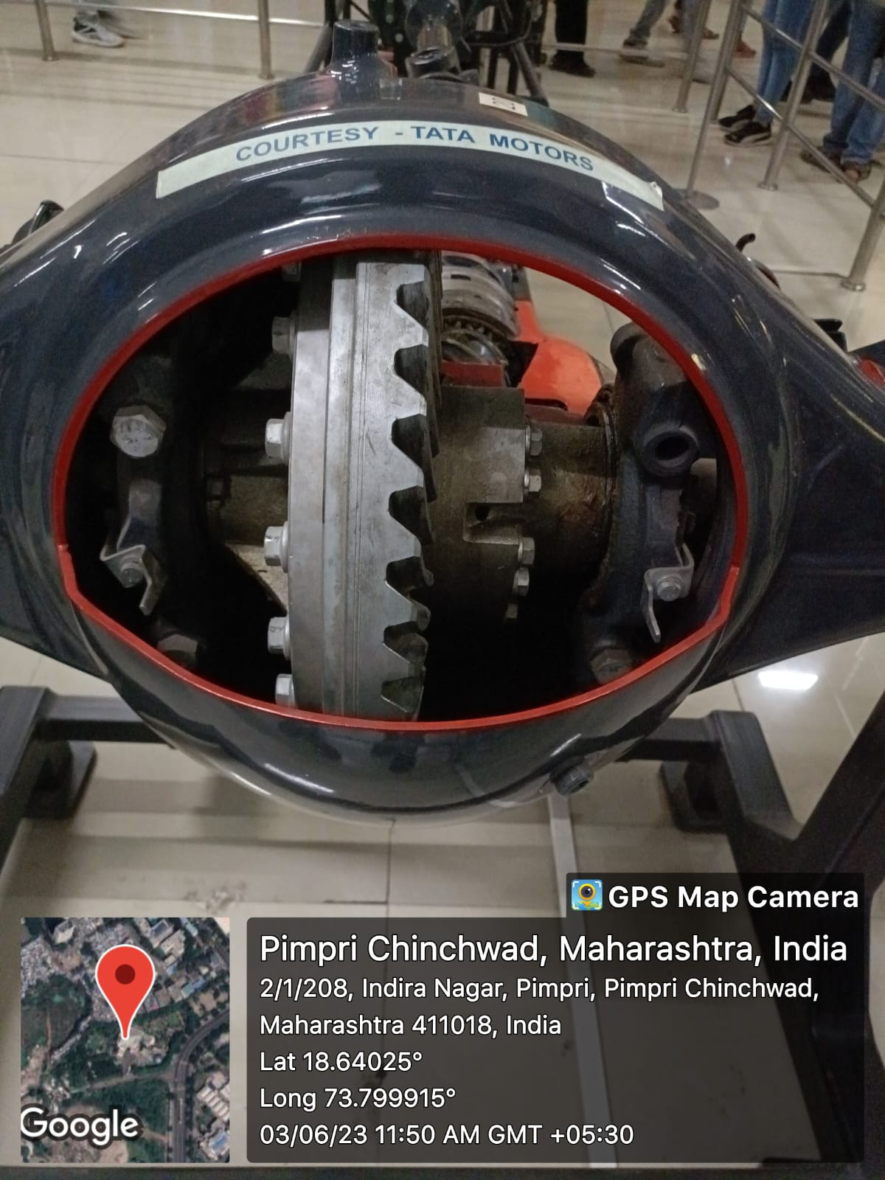
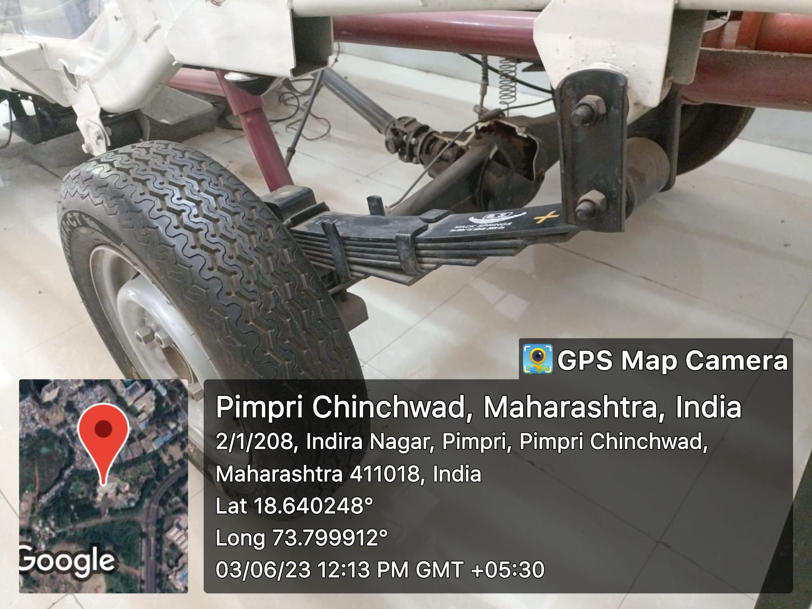

Slide 45




Slide 46

MODULE 10 Conic Sections

Slide 47


Slide 48


Slide 50

Activity carried under above Module

Slide 51

IA activity :-

Slide 52
2D Drafting Work

Slide 53

eSheet 1

Slide 54

eSheet 2

Slide 55

eSheet 3

Slide 56

eSheet 4

Slide 57

eSheet 5

Slide 58

eSheet 6

Slide 59
Any Project work carried
https://docs.google.com/presentation/d/14rljBj1IunYpbw5OkGNDAikS0_qXWrdBdjeLSgxsxAc/edit?usp=sharing

Slide 60
3D Modeling Work

Slide 61

Model 1

Slide 62

Notes:
Drafting Image

Slide 63
Model 2
Link for model :- https://a360.co/45WQJij
Link for Drafting :- https://a360.co/3MVd7jG

Slide 64

Model 3

Slide 65

Drafting

Slide 66

Model 4
Link for Model :- https://a360.co/3CoDp97

Slide 67

Model 5

Slide 68

Drafting

Slide 69
Major Learnings and Outcomes

Slide 70
Major outcomes from drawing work
Add at least 6 points in full statement e.g.
I learned identification of line types
I learned various constraints and functions/features which make drawing so easy.
I learned to apply constraints to objects and lines.
I learned to apply the Engineering Graphics course in this course and what the industry expects.
It helped me improve my Visual Analysis.
I learnt to create a realistic model of something in real life or what I have in mind.

Slide 71
Outcomes from Software work
Add at least 5 points
I learned how to use draw commands in Autocad
I learned to give constraints to objects.
I learned to find measurements of unknown objects using logic.
I learned draw 3D model from 2D views.
I learned to calculate material required to make a certain objects I have in mind.

